Slide 1
Machine Learning
Sponsored by:
Yale Center for Biomedical Data Science
Yale Center for Medical Informatics
Yale Biomedical Data Summer Course
Day 4
Lecturers:
Prashant Emani
Jonathan Warrell
from the Gerstein lab in the Dept. of Molecular Biophysics and Biochemistry
Slide Design: Jonathan Warrell, Prashant Emani, Declan Clarke
Date: July 25th, 2019

Slide 2
Outline
Introduction to Machine Learning: basic concepts and intro to scikit-learn Python package
Unsupervised Learning:
PCA, Hierarchical Clustering, K-means Clustering
”Linear” Supervised learning:
Linear Regression, Logistic Regression, Regularization, Random Forest/Tree-based methods
“Non-linear” Supervised Learning:
SVMs, Neural Network Models
Model Evaluation:
Cross-validation, AUC, Interpretation

Slide 3
Machine Learning: Definition and Basic concepts
Machine learning is the process of finding patterns in data, as outsourced to computers.
In other words, we deem it “machine learning” when a computer, under certain guiding principles, finds a representation of the structure in data such that it can subsequently approximate the complex phenomenon in similar settings.
“guiding principles”: Human-directed rules and/or optimization goals
“representation, approximate”: Never an exact representation of the data, due to noise and/or heuristic nature of model
“similar”: Generalizability depends on degree of shared structure

Slide 4
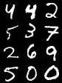
Examples of Machine Learning (ML) in practice
MNIST dataset: Classification
of handwritten digits
AlphaGo: Teaching a computer to win at Go
http://yann.lecun.com/exdb/mnist/
https://github.com/teavanist/MNIST-JPG
Silver et al. 2016, Nature 529, Pgs. 484-489.

Slide 5
Broad categories of ML algorithms (based on degree of human supervision)
Supervised Learning:
Training a model based on a set of “gold standard” {input, target output} pairs
Guiding principles: Structure is reflected in target output for a given input, so need to infer it
Unsupervised Learning:
Discovering structure in data in the absence of curated set of target output
Guiding Principles: Optimize (maximize or minimize) some target metric that tells you about the data samples and/or the features most important to structure determination
Reinforcement Learning:
Discovering the rules of a task without curated data, but with some sense of reward
Guiding Principles: Choose best sequence of steps to maximize long-term reward

Slide 6
Examples of the three categories
Supervised:
Classify blood samples into cancer/non-cancer
Predict chances of rain based on historical patterns, related to temperature and pressure
Find text descriptions of images
Netflix recommendations
Unsupervised:
Build an evolutionary tree of finches based on similarity of beak shapes, body size, and other physiological features
Cluster cells together based on gene expression, to yield groups of similar brain cell types
Reinforcement learning:
AlphaGo learning to play Go, where the reward is winning
Self-driving cars learning to avoid obstacles, where the reward is successfully arriving at the destination with no accidents

Slide 7
General questions before applying ML
What is the goal of your analysis?
Are you categorizing samples?
Are you predicting a quantity?
Are you looking for some structure in the data, without knowing what form it may take?
Will the dataset allow you to reach your intended goal?
Do you have labeled data from different categories for training?
Do you have appropriate controls?
Are there any confounding factors?
Are your datasets balanced?
Do you have appropriate statistical measures in place?
Is the data appropriately processed?

Slide 8
General strategy for choosing ML approaches

Slide 9
General strategy for choosing ML approaches(contd.)
Unsupervised:
Principal Component Analysis (PCA): Dimensional reduction, clustering similar samples, prioritizing features
Hierarchical Clustering: Inferring relative distance of samples to build trees
K-means Clustering: Finding cluster centroids
Supervised:
Linear Regression: Predict level of a continuous variable based on linear combination of other variables
Classifiers: Predict level of a binary/categorical variable based on other variables
Logistic Regression
Random Forest
Support Vector Machines (SVMs)
Neural Network Models: General-purpose classifiers/predictors built from layers of simpler models

Slide 10
Avoiding bias, Part I: Balancing datasets and accounting for confounding factors
Imagine designing a classifier differentiating between patients with high blood pressure (BP) and normal-range BP using features of diet, smoking, exercise, medicine info:
Consider that your cohort includes 90 patients with high BP and 10 with normal-range BP, and your test set reflects the same.
Your classifier has 89% accuracy! Yay?
No! Nein! A classifier that randomly picks samples should give you a classification of high BP 90% of the time!
You need to improve upon a random classifier. Usually, if you have sufficient samples, you can subsample to choose a more balanced cohort. Also, choose performance metrics other than accuracy.
Equally essential, are “confounding factors”:
These are potentially unobserved variables that mimic the target effect.
Eg: Family and Population structure in Genome-Wide Association Studies (GWAS)

Slide 11
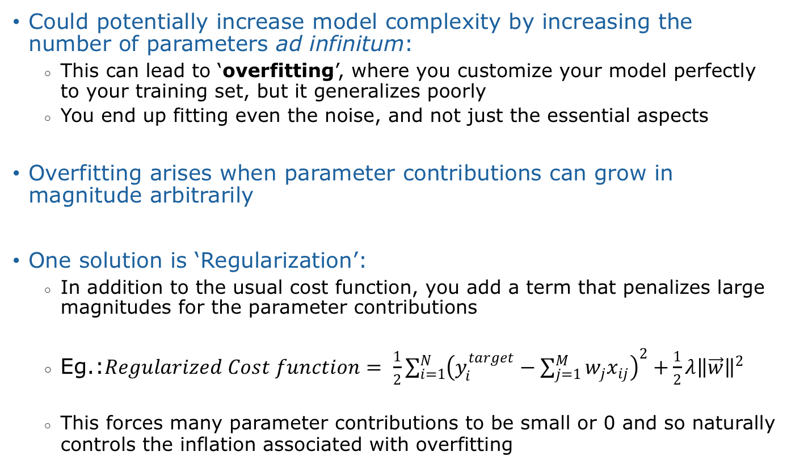
Avoiding bias, Part II: Overfitting
Could potentially increase model complexity by increasing the number of parameters ad infinitum:
This can lead to ‘overfitting’, where you customize your model perfectly to your training set, but it generalizes poorly
You end up fitting even the noise, and not just the essential aspects
Overfitting arises when parameter contributions can grow in magnitude arbitrarily
One solution is ‘Regularization’:
In addition to the usual cost function, you add a term that penalizes large magnitudes for the parameter contributions
Eg.:$Regularized Cost function= \frac{1}{2}\sum_{i=1}^{N}{{\left(y_{i}^{target}−\sum_{j=1}^{M}{w_{j}x_{ij}}\right)}^{2}+}\frac{1}{2}λ{\left\|\vec{w}\right\|}^{2}$
This forces many parameter contributions to be small or 0 and so naturally controls the inflation associated with overfitting

Slide 12
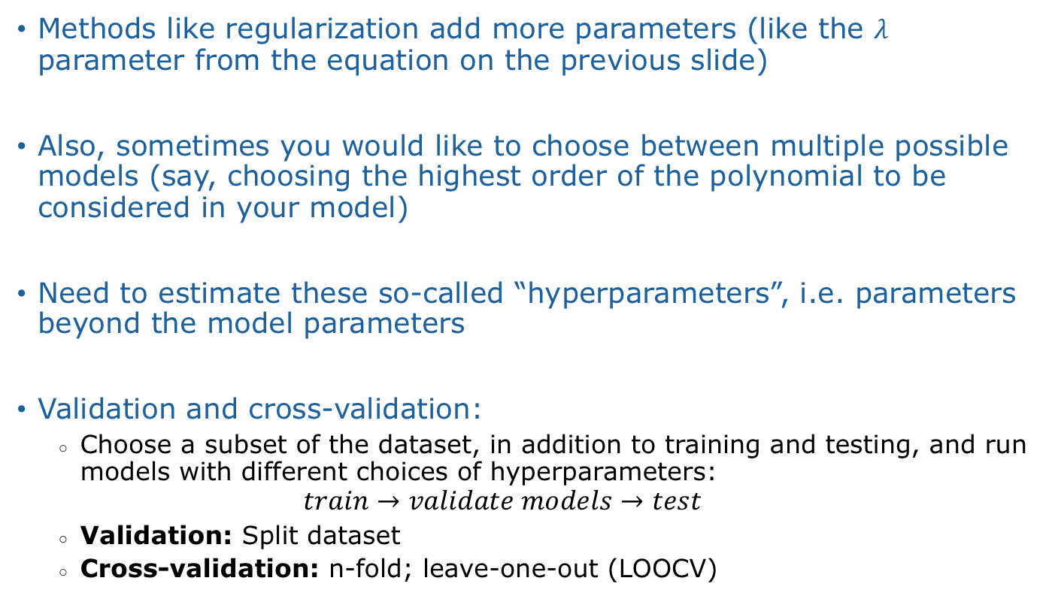
Avoiding bias, Part III: Validation, Cross-validation and model selection
Methods like regularization add more parameters (like the $λ$ parameter from the equation on the previous slide)
Also, sometimes you would like to choose between multiple possible models (say, choosing the highest order of the polynomial to be considered in your model)
Need to estimate these so-called “hyperparameters”, i.e. parameters beyond the model parameters
Validation and cross-validation:
Choose a subset of the dataset, in addition to training and testing, and run models with different choices of hyperparameters:
$$train→validate models→test$$
Validation: Split dataset
Cross-validation: n-fold; leave-one-out (LOOCV)

Slide 13
Avoiding bias, Part IV: Avoiding prejudiced models
There is a myth that ML is agnostic and unprejudiced because the human element is removed.
But ML algorithms are only as free from bias as the people who program them.
Sources of bias:
Datasets not reflective of diversity: Eg., lack of ethnic diversity in many, many genomics studies.
Choice of parameters: The assumption that the only parameters that matter are those that can be easily measured is potentially problematic.
Confirmation bias: With preponderance of methods, could cherry-pick the one that fulfills preconceived notions
Extremely important when these are used to make medical or policy decisions that could affect many lives.

Slide 14
Structure of each ML section
Definition: Qualitative Description
Context of use with examples: When to use the method, potential limitations
Mathematical formulation: Mostly linear algebra and basic calculus
Cost function (or Guiding Principle): Every ML method is based on optimizing a certain quantity that significantly affects the results
Relevant scikit-learn code: This code will be relevant for the lab sections

Slide 15
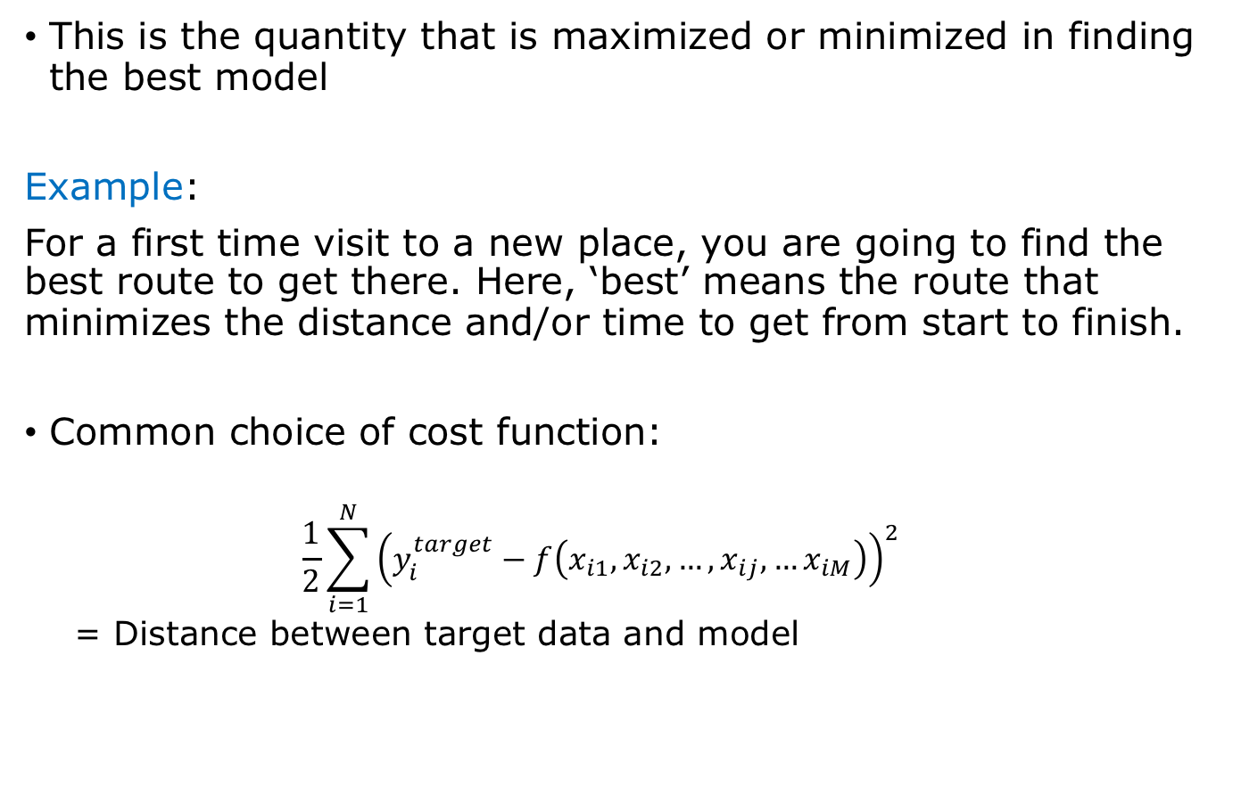
Cost function
This is the quantity that is maximized or minimized in finding the best model
Example:
For a first time visit to a new place, you are going to find the best route to get there. Here, ‘best’ means the route that minimizes the distance and/or time to get from start to finish.
Common choice of cost function:
$$\frac{1}{2}\sum_{i=1}^{N}{{\left(y_{i}^{target}−f\left({x_{i1},x}_{i2},…,x_{ij},…x_{iM}\right)\right)}^{2}}$$
= Distance between target data and model
Data to be fit
Model being fit
to data

Slide 16
Q&A

Slide 17
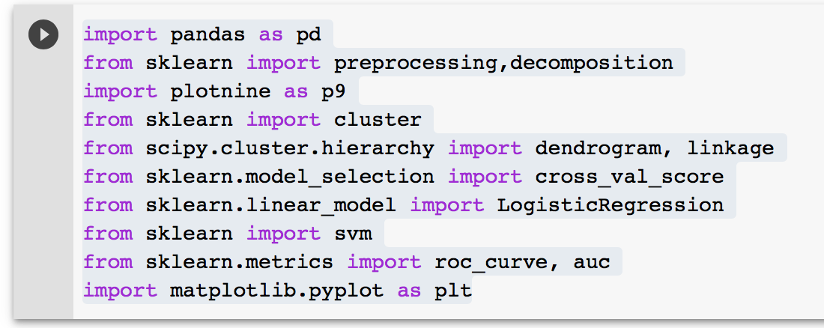
Introduction to scikit-learn
1. Import Libraries and Functions
2. Create objects of relevant classes: Object-oriented programming
3. For an object, call necessary functions

Slide 18
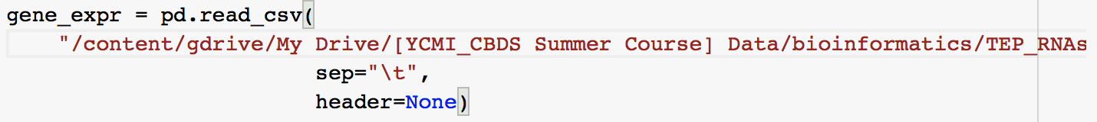
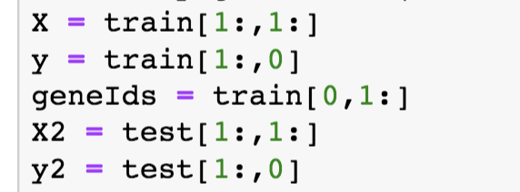
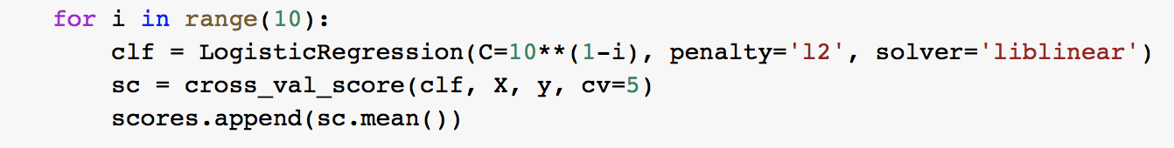
Additional coding structures
4. Read files into pandas dataframes
5. Array subsetting
6. For loops

Slide 19
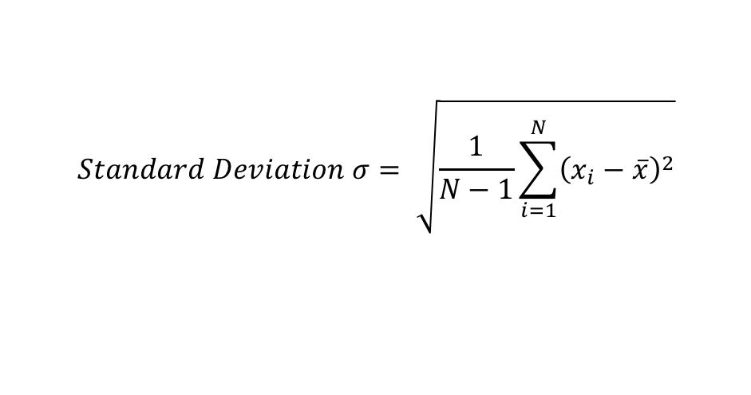
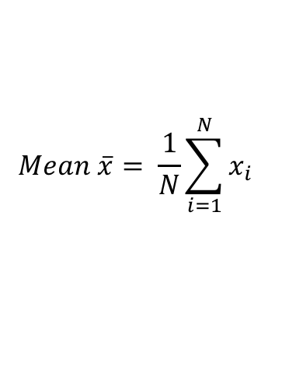
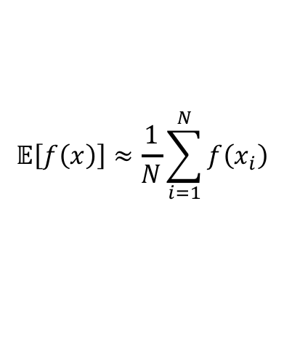
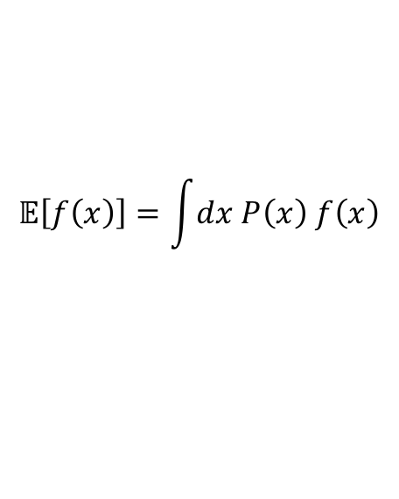
Statistical terms
1. Sample Mean:
$$Mean \overline{x}= \frac{1}{N}\sum_{i=1}^{N}{x_{i}}$$
2. Sample Standard Deviation:
$$Standard Deviation σ= \sqrt{\frac{1}{N−1}\sum_{i=1}^{N}{{\left(x_{i}−\overline{x}\right)}^{2}}}$$
3. Expectation values:
$$𝔼\left[f\left(x\right)\right]≈\frac{1}{N}\sum_{i=1}^{N}{f\left(x_{i}\right)}$$
$$𝔼\left[f\left(x\right)\right]=\int{dx P\left(x\right) f\left(x\right)}$$
for known, continuous distributions
when samples are drawn from the underlying distribution

Slide 20

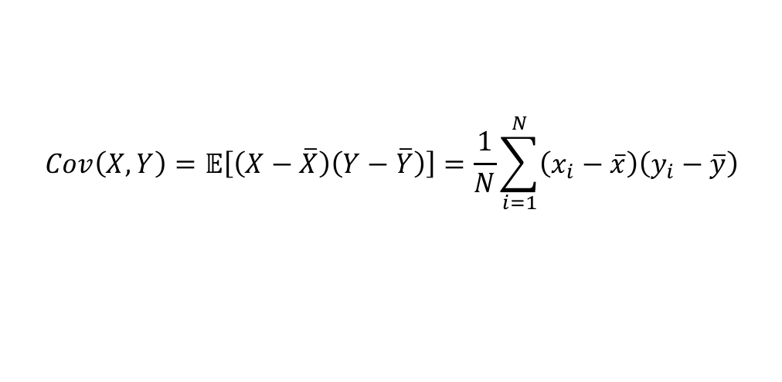
Statistical terms (contd.)
4. Covariance between two variables:
$$Cov\left(X,Y\right)=𝔼\left[\left(X−\overline{X}\right)\left(Y−\overline{Y}\right)\right]=\frac{1}{N}\sum_{i=1}^{N}{\left(x_{i}−\overline{x}\right)\left(y_{i}−\overline{y}\right)}$$
5. Correlation between two variables:
$$Corr\left(X,Y\right)=\frac{Cov\left(X,Y\right)}{σ_{X}σ_{Y}}=\frac{𝔼\left[\left(X−\overline{X}\right)\left(Y−\overline{Y}\right)\right]}{σ_{X}σ_{Y}}$$

Slide 21
References
Pattern Recognition and Machine Learning, Christopher M. Bishop, Springer 2006.

Slide 22
Unsupervised Learning I: Principal Component Analysis (PCA)
Definition: PCA is the construction of a set of new variables — a linear combination of the original variables (or equivalently, a rotation of the original variables) — where the covariance matrix is: (a) diagonalized; and (b) ranked in descending order of variance.
In short, find the directions along which the data is most “spread-out”.
Context of use with examples:
PCA is used for
Reducing the number of dimensions to the most important ones
Discover structure, by identifying relevant variables
Example:
Torsion angles (~70 different ones) along the backbone of RNA can be used to identify clusters of RNA conformation

Slide 23
Principal Component Analysis (PCA) (contd.)
PC2
PC1
Emani et al 2014, J. Phys. Chem. B, 118, Pgs. 1726-1742

Slide 24
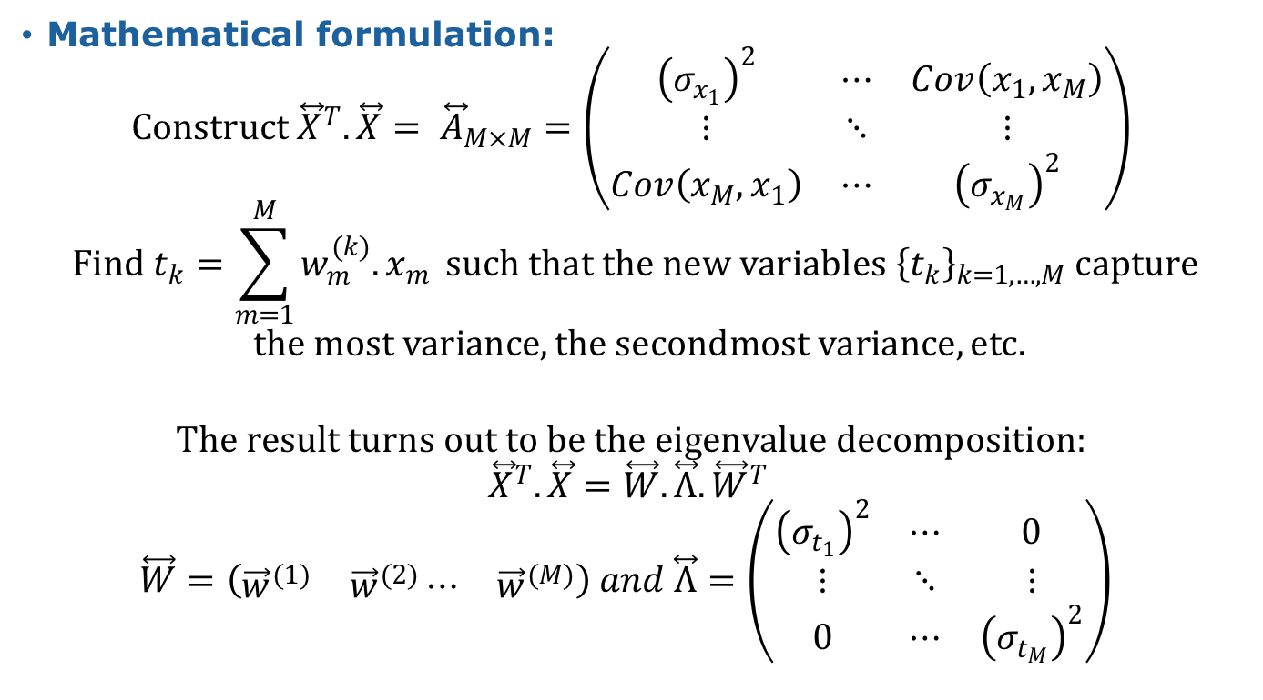
Principal Component Analysis (PCA) (contd.)
Mathematical formulation:
$$Construct {\overset{⃡}{X}}^{T}.\overset{⃡}{X}= {\overset{⃡}{A}}_{M×M}=\left(\begin{matrix}{\left(σ_{x_{1}}\right)}^{2} & ⋯ & Cov\left(x_{1},x_{M}\right) \\ ⋮ & ⋱ & ⋮ \\ Cov\left(x_{M},x_{1}\right) & ⋯ & {\left(σ_{x_{M}}\right)}^{2}\end{matrix}\right)$$
$$Find t_{k}=\sum_{m=1}^{M}{w_{m}^{(k)}.x_{m}} such that the new variables {\left\{t_{k}\right\}}_{k=1,…,M} capture$$
$$the most variance, the secondmost variance, etc.$$
$$The result turns out to be the eigenvalue decomposition:$$
$${\overset{⃡}{X}}^{T}.\overset{⃡}{X}=\overset{⃡}{W}.\overset{⃡}{Λ}.{\overset{⃡}{W}}^{T}$$
$$\overset{⃡}{W}=\left(\begin{matrix}{\vec{w}}^{(1)} & {\vec{w}}^{(2)}⋯ & {\vec{w}}^{(M)}\end{matrix}\right) and \overset{⃡}{Λ}=\left(\begin{matrix}{\left(σ_{t_{1}}\right)}^{2} & ⋯ & 0 \\ ⋮ & ⋱ & ⋮ \\ 0 & ⋯ & {\left(σ_{t_{M}}\right)}^{2}\end{matrix}\right)$$

Slide 25
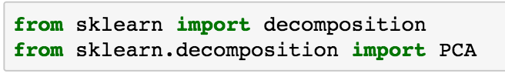
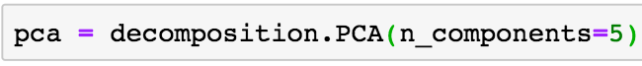
Principal Component Analysis (PCA) (contd.)
Cost function/Guiding Principle: Choose weights of new variables such that variance is maximized in decreasing order of contribution to the total variance
scikit-learn Code:
Import libraries:
Define objects and number of components:
Project your data onto the top ‘n_components’; this is the dimensional reduction step (data_matrix with features as columns and samples as rows):

Slide 26
Unsupervised Learning II: Hierarchical Clustering
Definition: Hierarchical Clustering is the process of successively clustering (agglomerative clustering) or dividing (divisive clustering) groups of samples using measures of the relative (dis)similarity between them, until all the samples have been merged or separated, respectively.
In short, find the “ancestral” tree of samples, where each generation involves the merging/dividing of two subclusters.
Agglomerative: Keep merging clusters until all samples are in the same unified cluster
Divisive: Keep dividing clusters until all samples are separate
Context of use with examples:
Hierarchical Clustering is used for
Finding clusters in the data, by identifying relative relatedness between samples and larger patterns of grouping.
Example:
Clustering cells from the mouse brain based on gene expression patterns

Slide 27
Hierarchical Clustering (contd.): Example Dendrogram
Zeisel et al 2015, Science, 347(6226), Pgs. 1138-1141

Slide 28
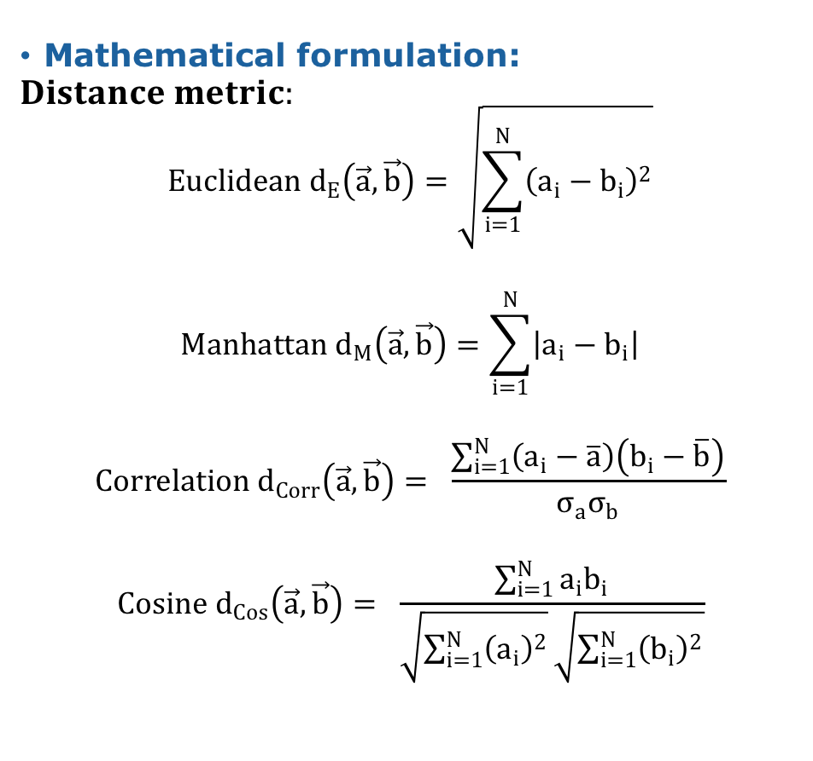
Hierarchical Clustering (contd.)
Mathematical formulation:
$$Distance metric:$$
$$Euclidean d_{E}\left(\vec{a},\vec{b}\right)=\sqrt{\sum_{i=1}^{N}{{\left(a_{i}−b_{i}\right)}^{2}}}$$
$$Manhattan d_{M}\left(\vec{a},\vec{b}\right)=\sum_{i=1}^{N}{\left|a_{i}−b_{i}\right|}$$
$$Correlation d_{Corr}\left(\vec{a},\vec{b}\right)= \frac{\sum_{i=1}^{N}{\left(a_{i}−\overline{a}\right)\left(b_{i}−\overline{b}\right)}}{σ_{a}σ_{b}}$$
$$Cosine d_{Cos}\left(\vec{a},\vec{b}\right)= \frac{\sum_{i=1}^{N}{a_{i}b_{i}}}{\sqrt{\sum_{i=1}^{N}{{\left(a_{i}\right)}^{2}}}\sqrt{\sum_{i=1}^{N}{{\left(b_{i}\right)}^{2}}}}$$

Slide 29
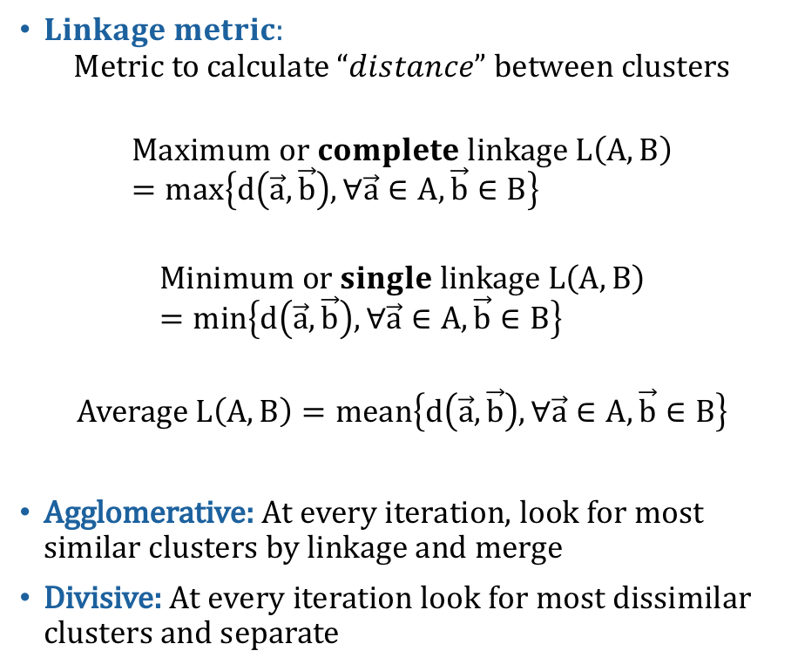
Hierarchical Clustering (contd.)
$Linkage metric:$
$$Metric to calculate “distance” between clusters$$
$$Maximum or complete linkage L\left(A,B\right)=max\left\{d\left(\vec{a},\vec{b}\right), ∀\vec{a}∈A, \vec{b}∈B\right\}$$
$$Minimum or single linkage L\left(A,B\right)=min\left\{d\left(\vec{a},\vec{b}\right), ∀\vec{a}∈A, \vec{b}∈B\right\}$$
$$Average L\left(A,B\right)=mean\left\{d\left(\vec{a},\vec{b}\right), ∀\vec{a}∈A, \vec{b}∈B\right\}$$
Agglomerative: At every iteration, look for most similar clusters by linkage and merge
Divisive: At every iteration look for most dissimilar clusters and separate

Slide 30
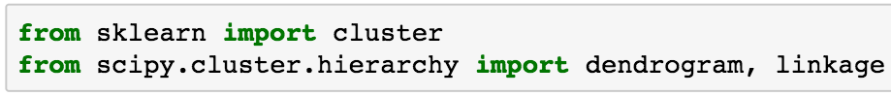
Hierarchical Clustering (contd.)
Cost function/Guiding Principle: Choose the merge/division sequence based on maximizing similarity/dissimilarity.
scikit-learn Code: Two different methods
Note: Will use scipy’s ‘linkage’ for the sake of plotting dendrograms
Import libraries:
Find linkage matrix/Define objects and number of clusters:
Plot dendrogram/Do a fit and predict cluster assignments:

Slide 31
Unsupervised Learning III: K-means Clustering
Definition: K-means Clustering is the assignment of samples to a pre-defined number (K) of clusters, by defining a set of cluster means such that the sum of the squared distance of points to their assigned means is minimized.
In short, find the optimal cluster assignments for points, and the optimal set of cluster reference points.
Context of use with examples:
K-means Clustering is used for
Identifying clusters in the multi-dimensional data, by identifying the prototypic cluster centers.
Example:
Finding clusters of resting-state functional connectivity (fMRI) patterns in the brain.

Slide 32
K-means Clustering (contd.)
Reinen et al 2018, Nat. Comm., 9:1157

Slide 33
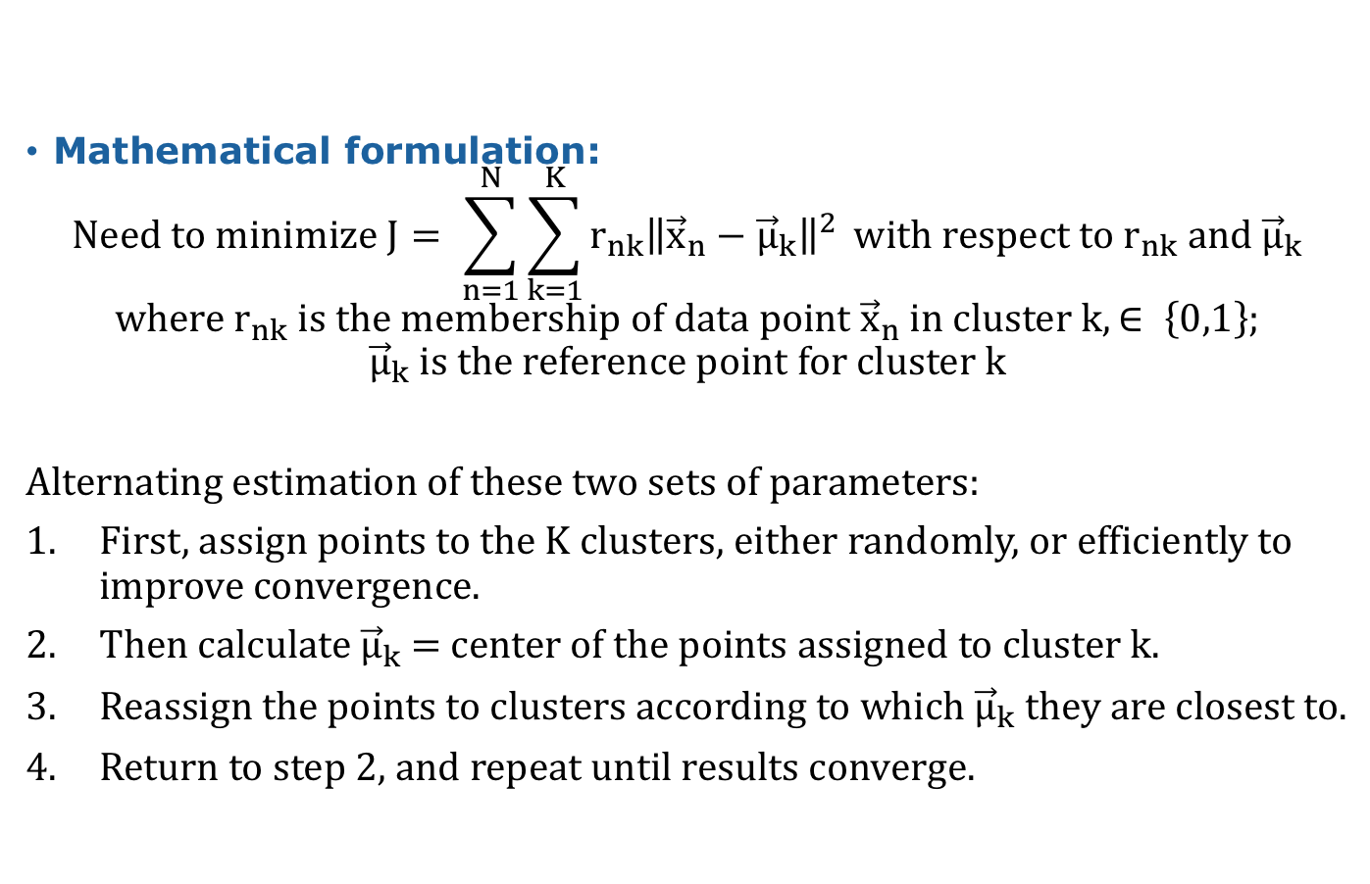
K-means Clustering (contd.)
Mathematical formulation:
$$Need to minimize J= \sum_{n=1}^{N}{\sum_{k=1}^{K}{r_{nk}{\left\|{\vec{x}}_{n}−{\vec{μ}}_{k}\right\|}^{2}}} with respect to r_{nk} and {\vec{μ}}_{k}$$
$$where r_{nk} is the membership of data point {\vec{x}}_{n} in cluster k, ∈ \left\{0,1\right\};$$
$${\vec{μ}}_{k} is the reference point for cluster k$$
Alternating estimation of these two sets of parameters:
First, assign points to the K clusters, either randomly, or efficiently to improve convergence.
Then calculate ${\vec{μ}}_{k}$ = center of the points assigned to cluster k.
Reassign the points to clusters according to which ${\vec{μ}}_{k}$ they are closest to.
Return to step 2, and repeat until results converge.

Slide 34
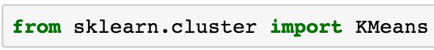
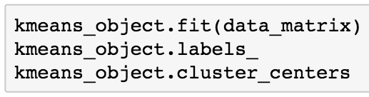
K-means Clustering (contd.)
Cost function/Guiding Principle: Identify clusters by minimizing the distance between samples and defined cluster centers.
scikit-learn Code:
Import libraries:
Define objects and number of clusters:
Do a fit and predict cluster assignments; extract cluster labels and centers:

Slide 35
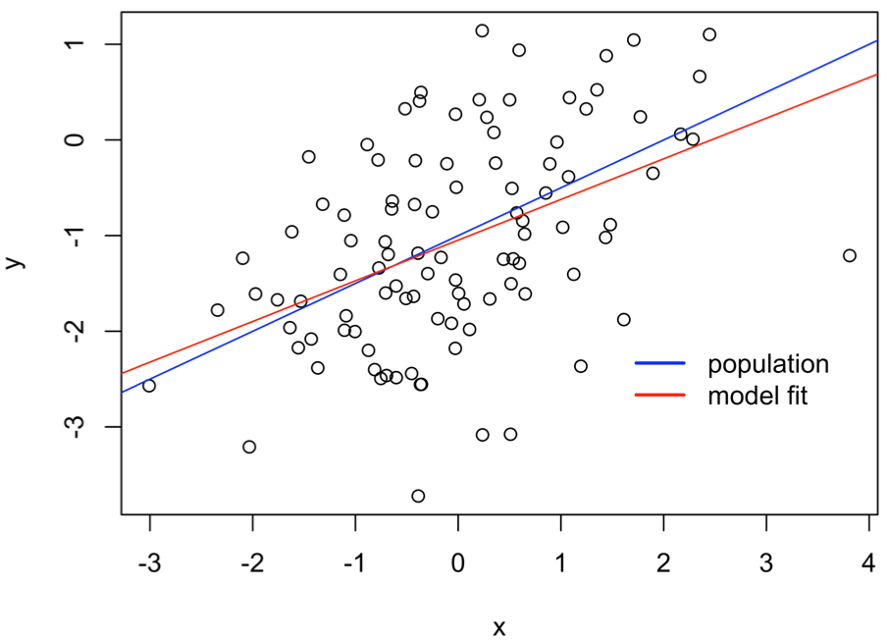
Supervised Learning Ia: Linear Regression
Definition: A simple model in which a response variable y is linearly dependent on predictor variable(s) → Build model to estimate population regression function
Data from James et al., 2013

Slide 36
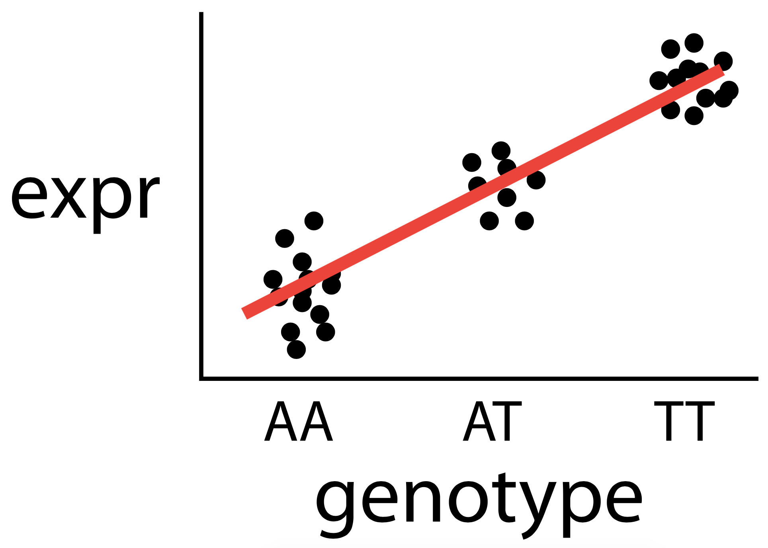
Linear Regression (contd.)
Context of use with examples: LR is used if you believe that changes in the response variable are directly proportional to changes in one or more independent variables.
Example: changes in gene expression as a consequence of genomic variants (ie., eQTLs)
TT
gene
AA
gene

Slide 37
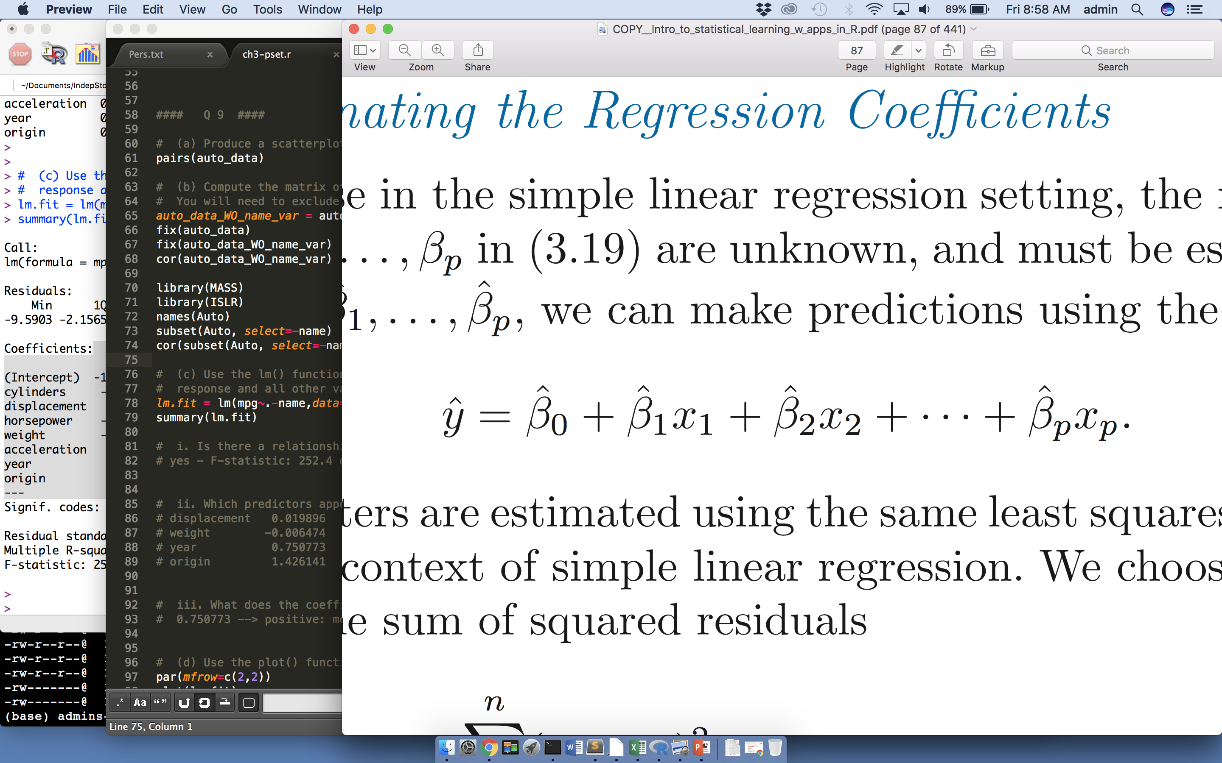
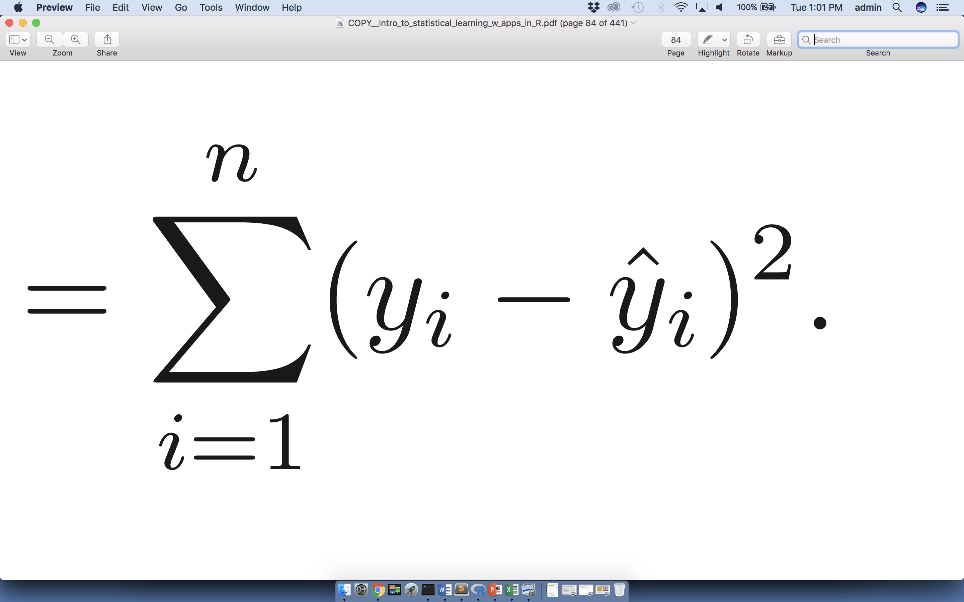
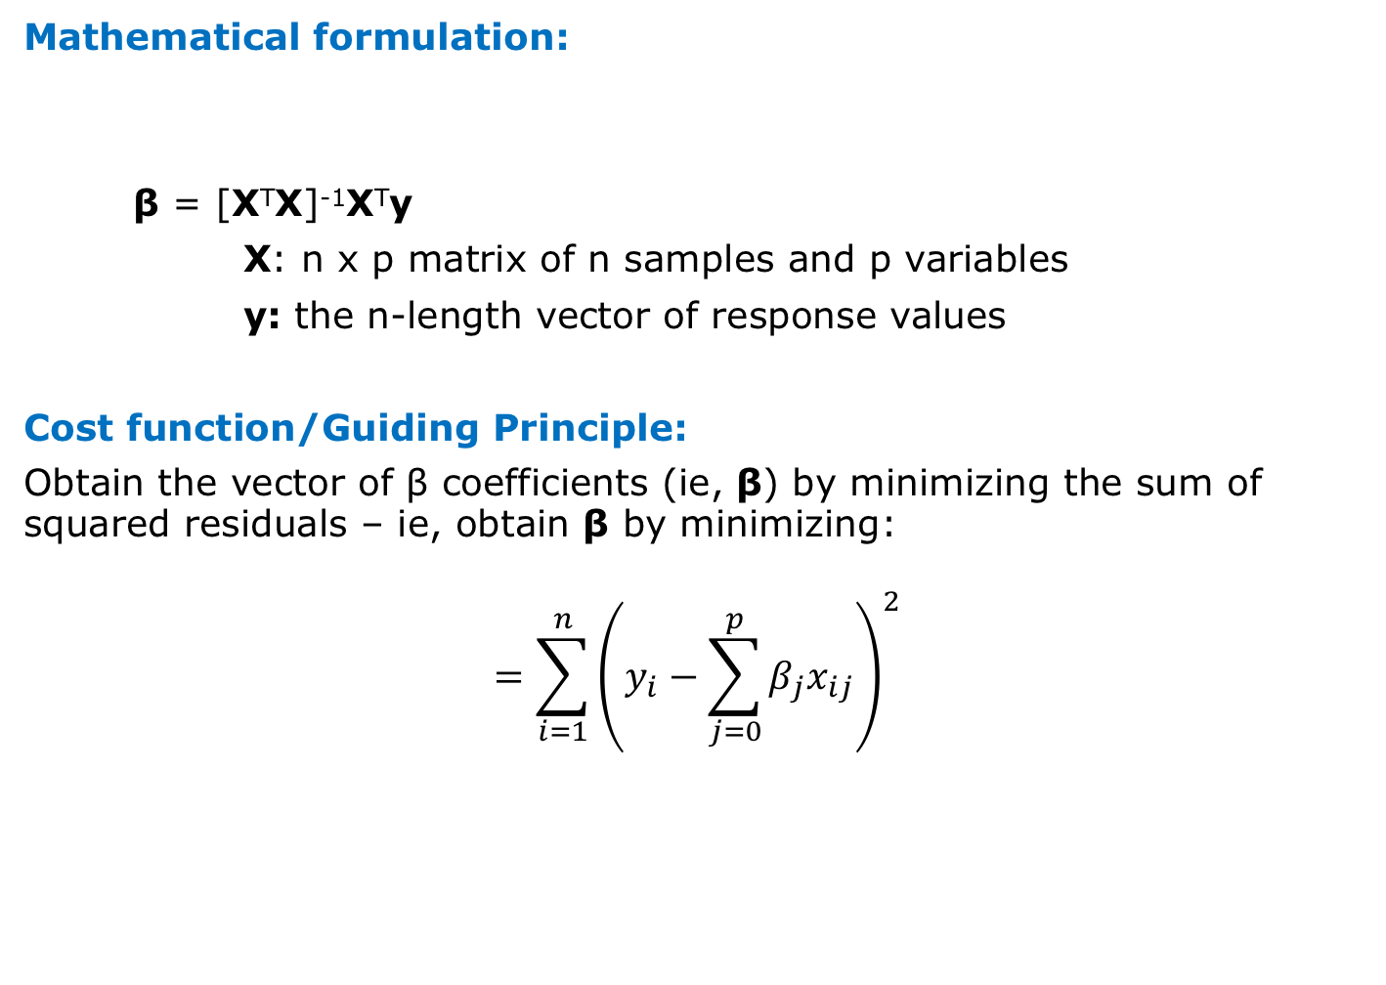
Linear Regression (contd.)
Mathematical formulation:
β = [X^{T}X]⁻¹X^{T}y
X: n x p matrix of n samples and p variables
y: the n-length vector of response values
Cost function/Guiding Principle:
Obtain the vector of β coefficients (ie, β) by minimizing the sum of squared residuals – ie, obtain β by minimizing:
$$=\sum_{i=1}^{n}{{\left(y_{i}−\sum_{j=0}^{p}{β_{j}x_{ij}}\right)}^{2}}$$

Slide 38
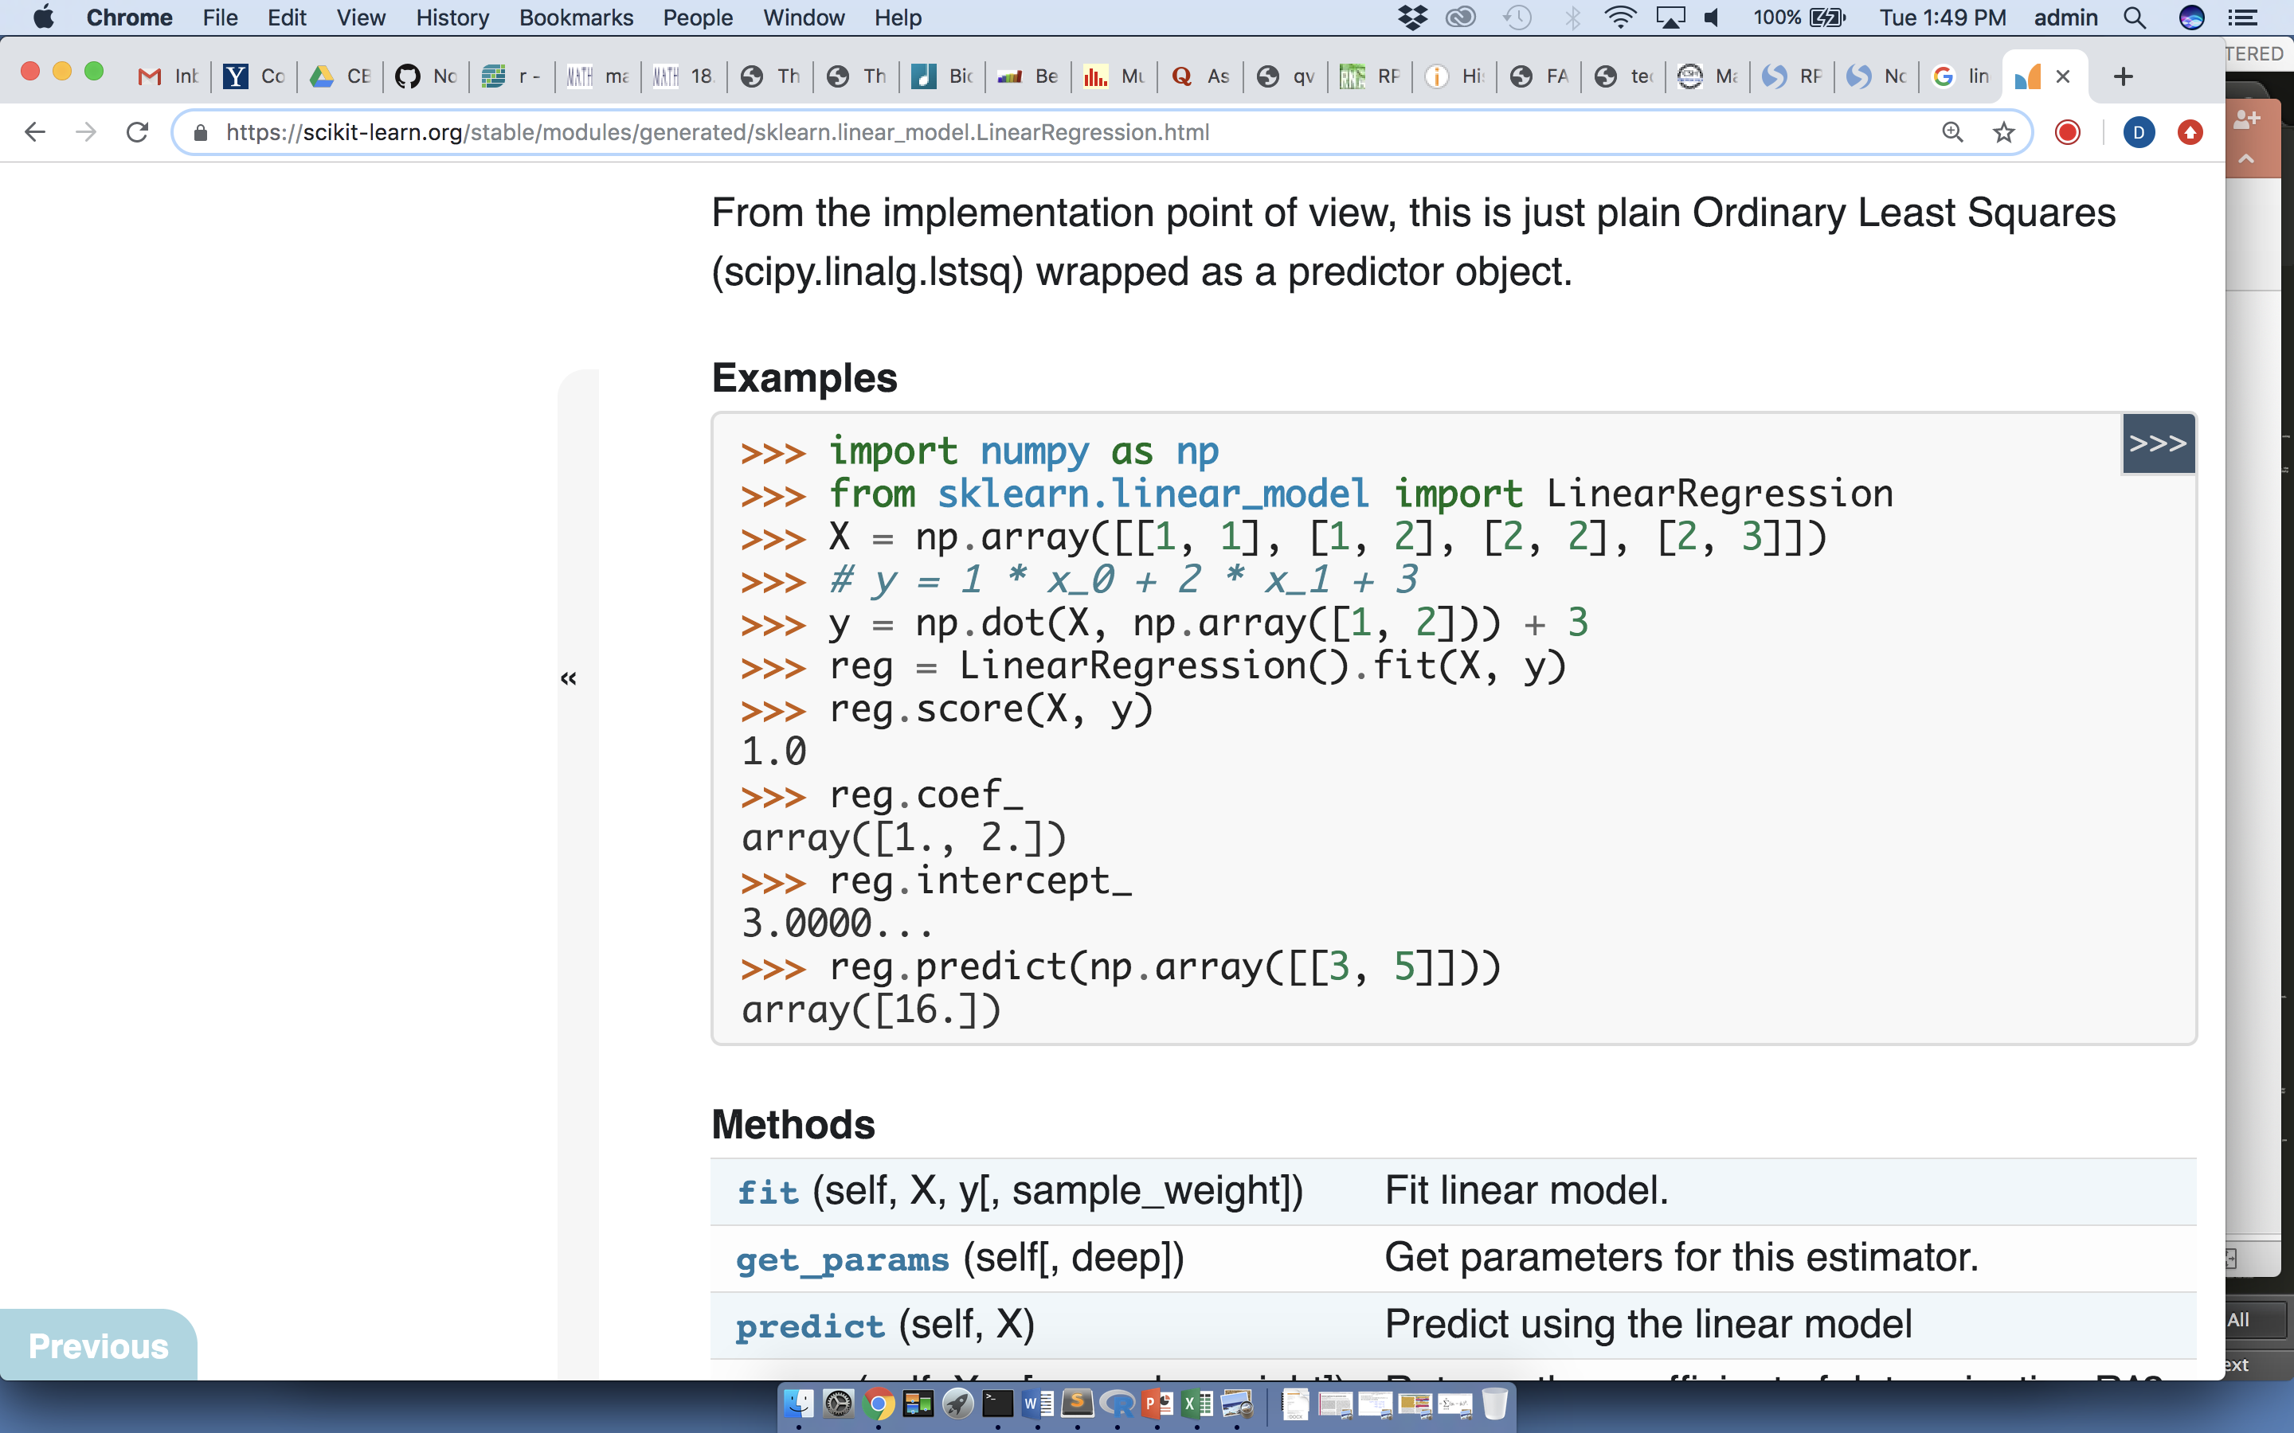
Linear Regression (contd.)
scikit-learn Code:
1. Import libraries:
2. Import data or explore method using synthetic dataset
3. Perform regression

Slide 39
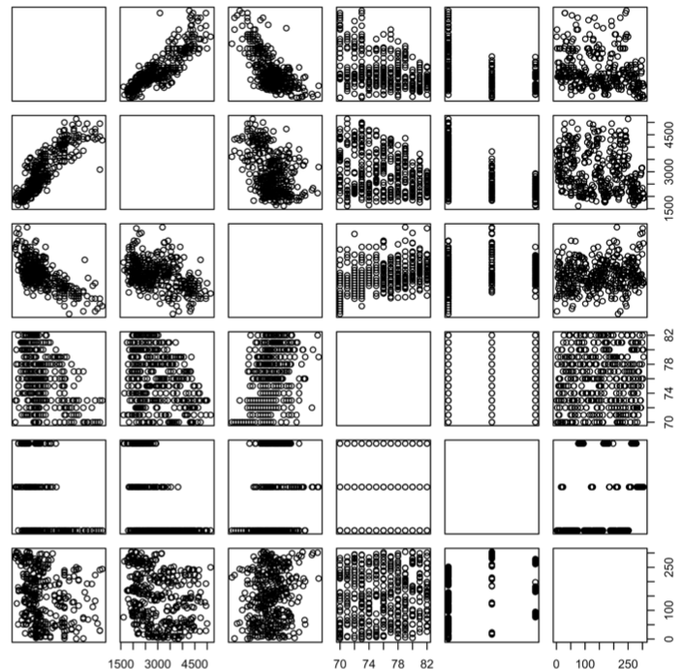
Linear Regression (contd.)
There may be many predictors available (A-F shown), in which pairwise relationships can easily be displayed graphically
A
B
C
D
E
F
Data from James et al., 2013

Slide 40
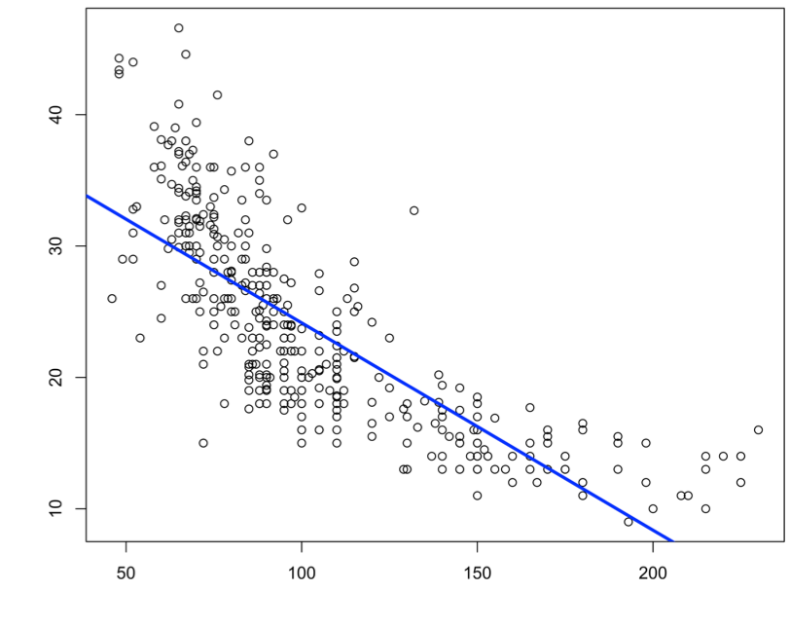
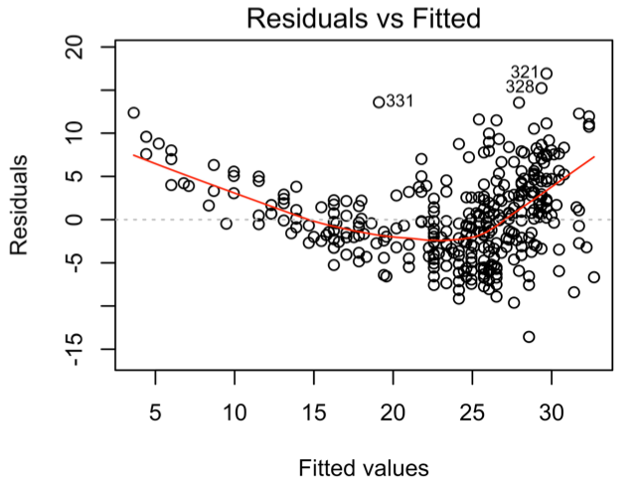
Linear Regression: Diagnostics
The relationship may not in fact be linear, in which case it may be necessary to also use transformations of the original variables (ex: polynomials). Check for non-linearity by plotting residuals.
*Note: a log transformation will be applied in your lab on Warfarin dosing.
Data from James et al., 2013

Slide 41
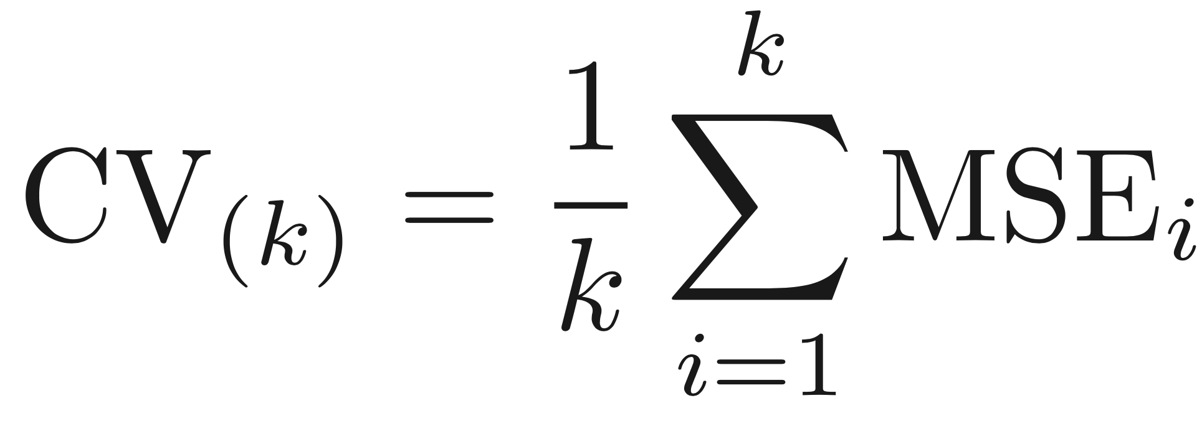
Linear Regression: Application of Cross-Validation
Sub-sample the data using k-fold cross-validation in order to perform parameter selection and/or to set parameter values
5-fold cross-validation schematized here

Slide 42
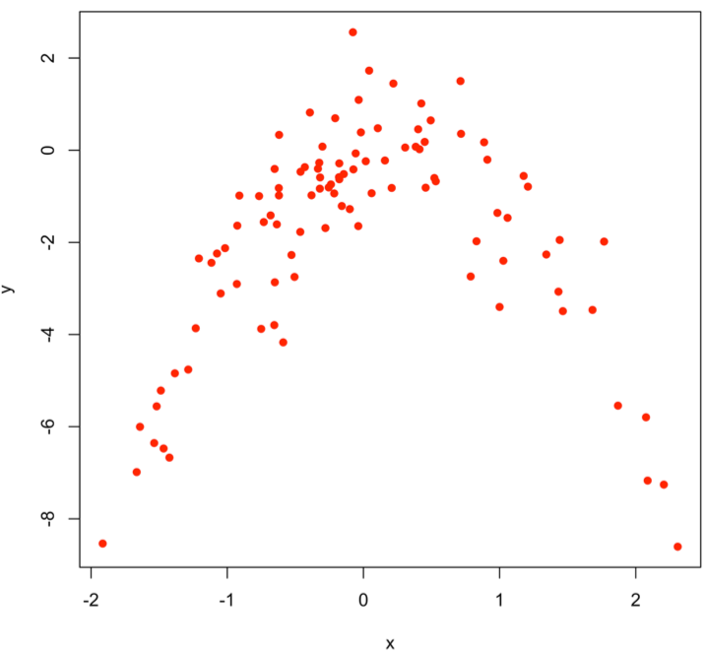
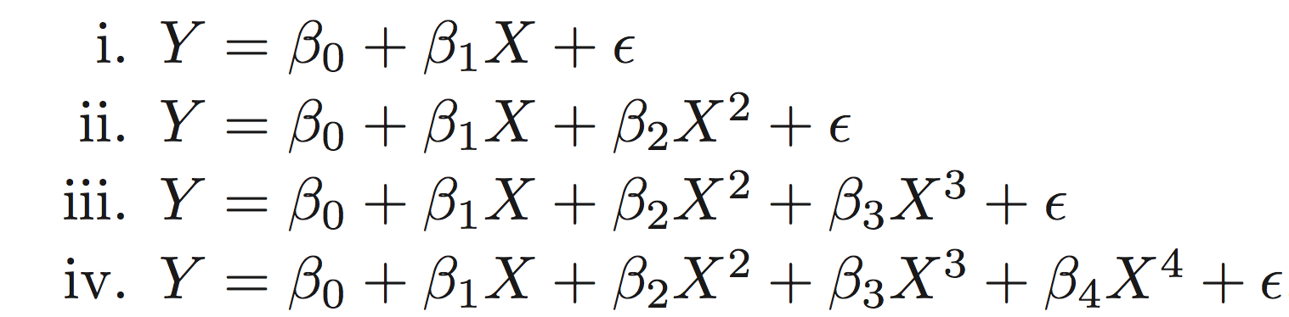
Linear Regression: Application of Cross-Validation
Sub-sample the data using k-fold cross-validation in order to perform parameter selection and/or to set parameter values
cv.error_i: 5.890979
cv.error_ii: 1.086595
cv.error_iii: 1.102585
cv.error_iv: 1.114772

Slide 43
Supervised Learning Ib: Lasso for Regularization
Definition: Similar to linear regression, but instead of just trying to minimize the squared errors in our training data, we simultaneously aim to:
eliminate irrelevant variables by setting their associated coefficient values to 0 → This is good! It accomplishes variable selection (thereby making models simpler, and thus more interpretable).
reduce the magnitudes of the coefficients (i.e, β_{j}) associated with the relevant variables → This is also good! It can often make the model more “stable” by reducing the variance of the response value being estimated. This reduction in variance often leads to improved predictive performance

Slide 44
Lasso for Regularization
Context of use with examples:
TT
gene
AA
gene
gender
age
local methylation status
AA
gene
disease type
tissue
ancestry
lab
copy number variants

Slide 45
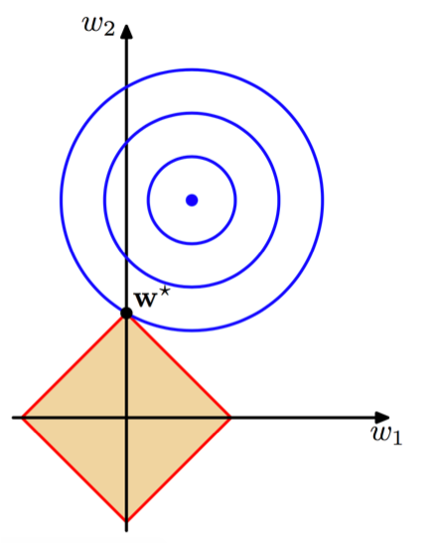
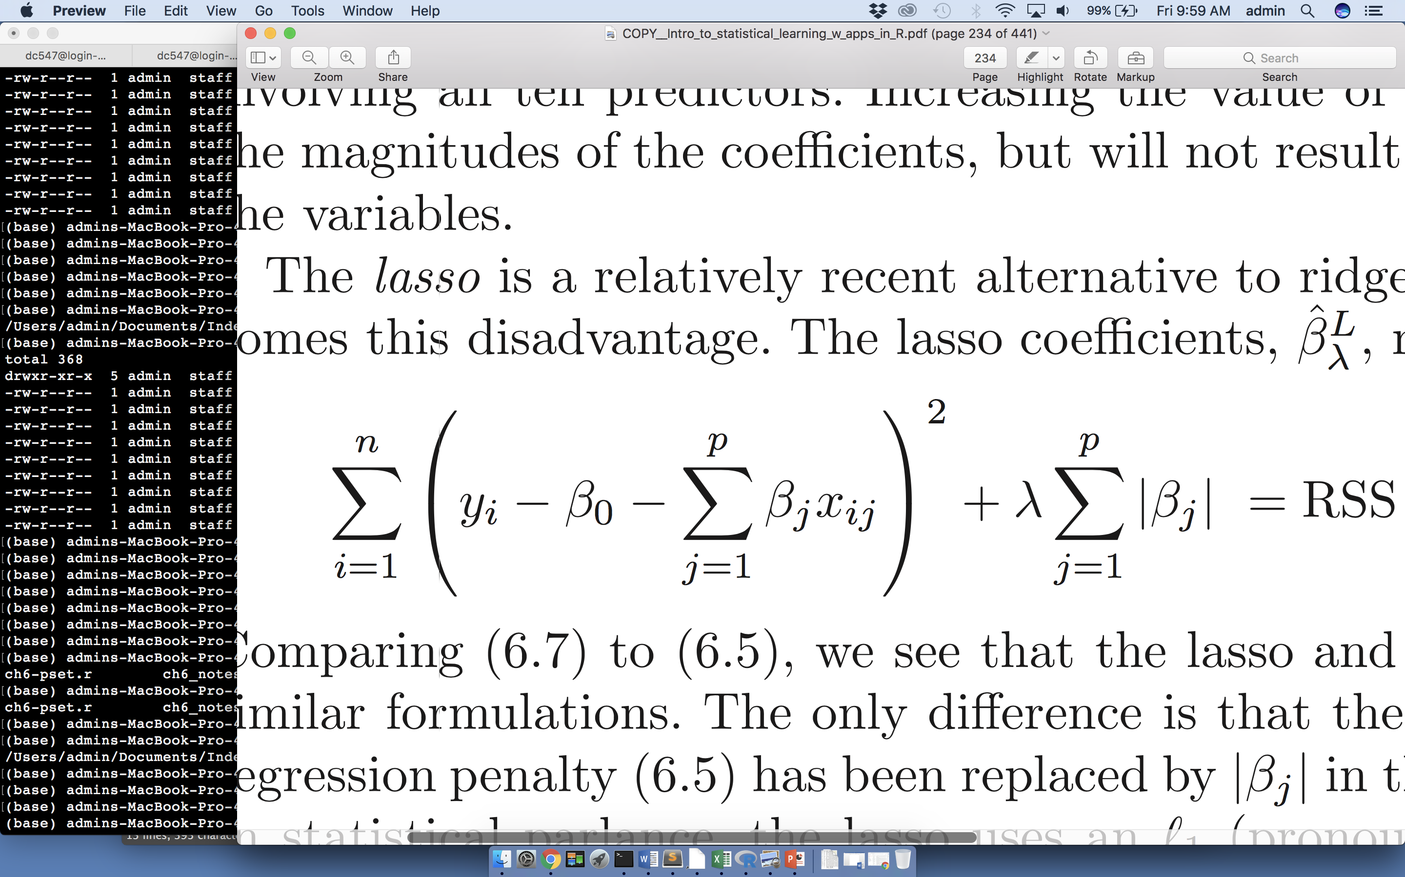
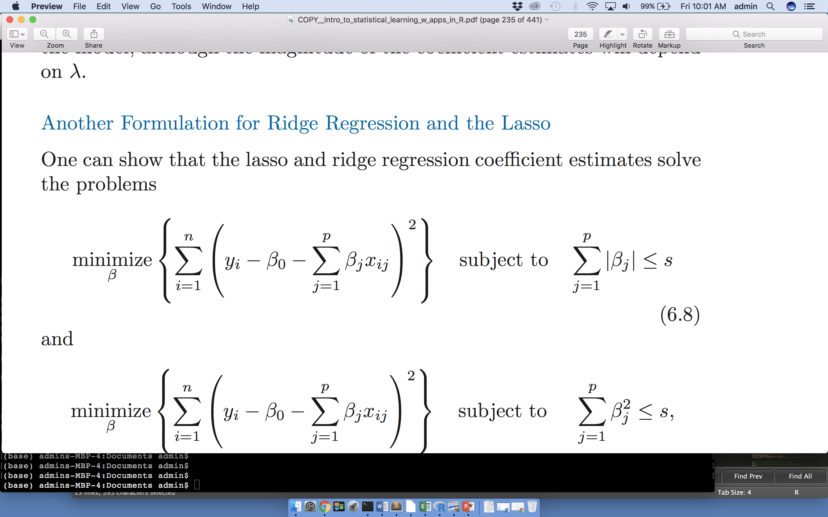
Lasso for Regularization
Mathematical formulation:
β₂
β₁
Adapted from
C. Bishop, 2006
Cost function/guiding principle:
Reduce the magnitude of the regression coefficients while fitting the data

Slide 46
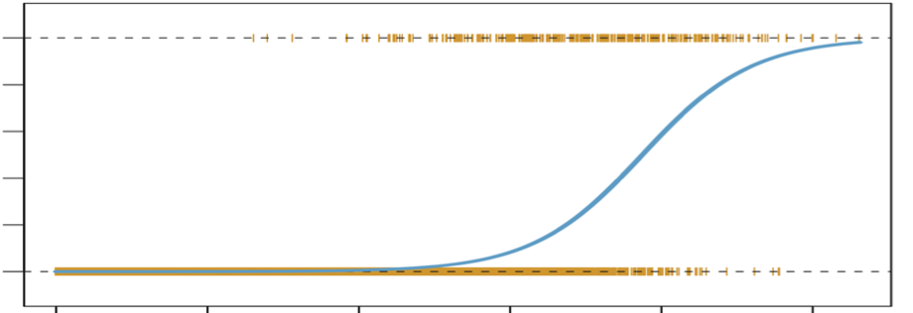
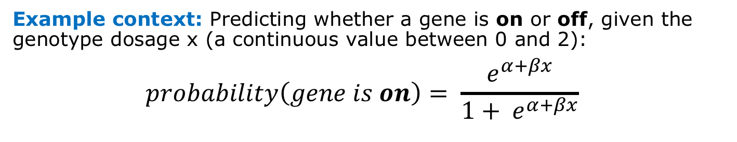
Supervised Learning II: Logistic Regression (Predicting binary outcomes)
Definition/Description: The variable you’re trying to predict might be a binary variable. Logistic regression allows you to use a training dataset to estimate the probability p that the response y will lie in one or the other of 2 different classes.
Example context: Predicting whether a gene is on or off, given the genotype dosage x (a continuous value between 0 and 2):
$$probability\left(gene is on\right)= \frac{e^{α+βx}}{1+ e^{α+βx}}$$
Prob (gene is on)
0 1
Adapted from
James et al., 2013
0 2
Genotype dosage (x)

Slide 47
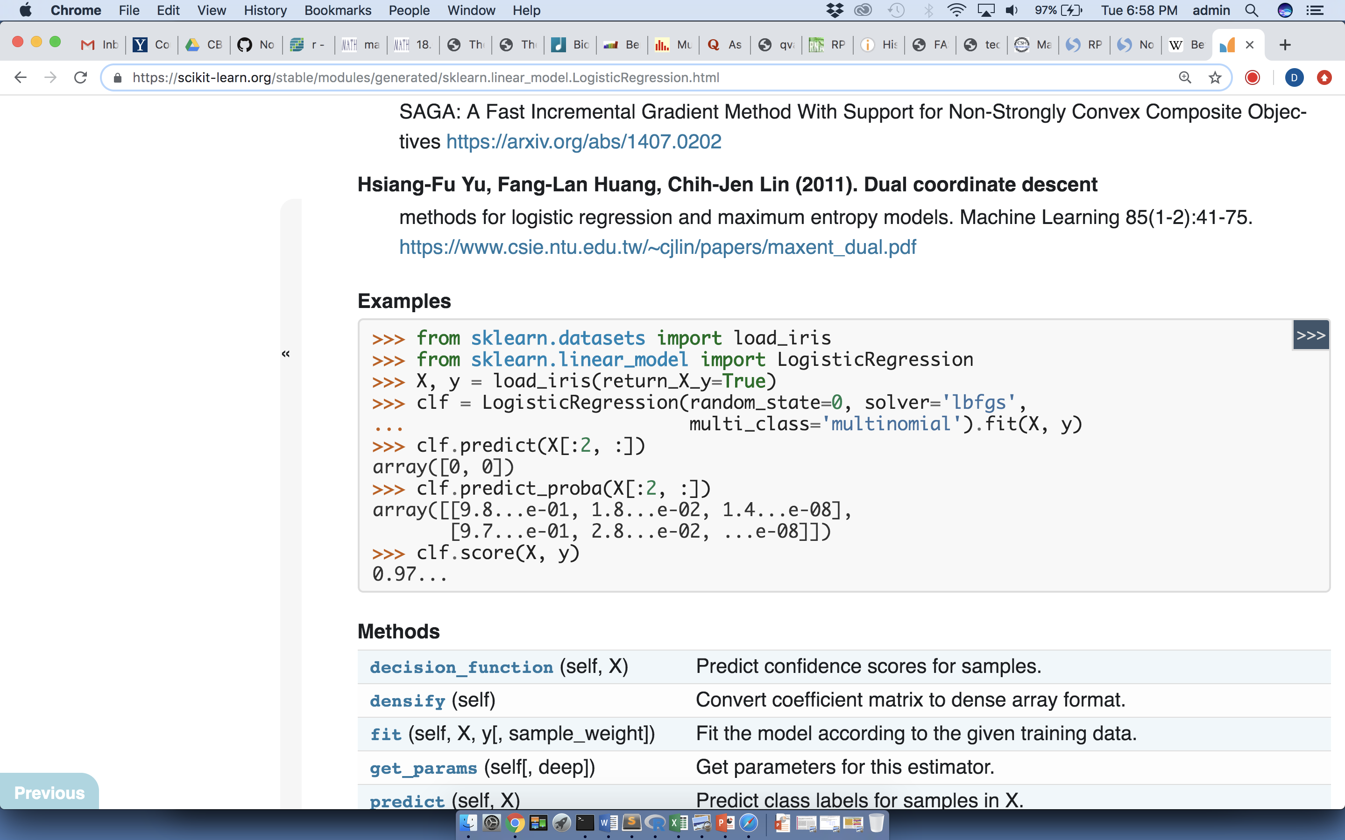
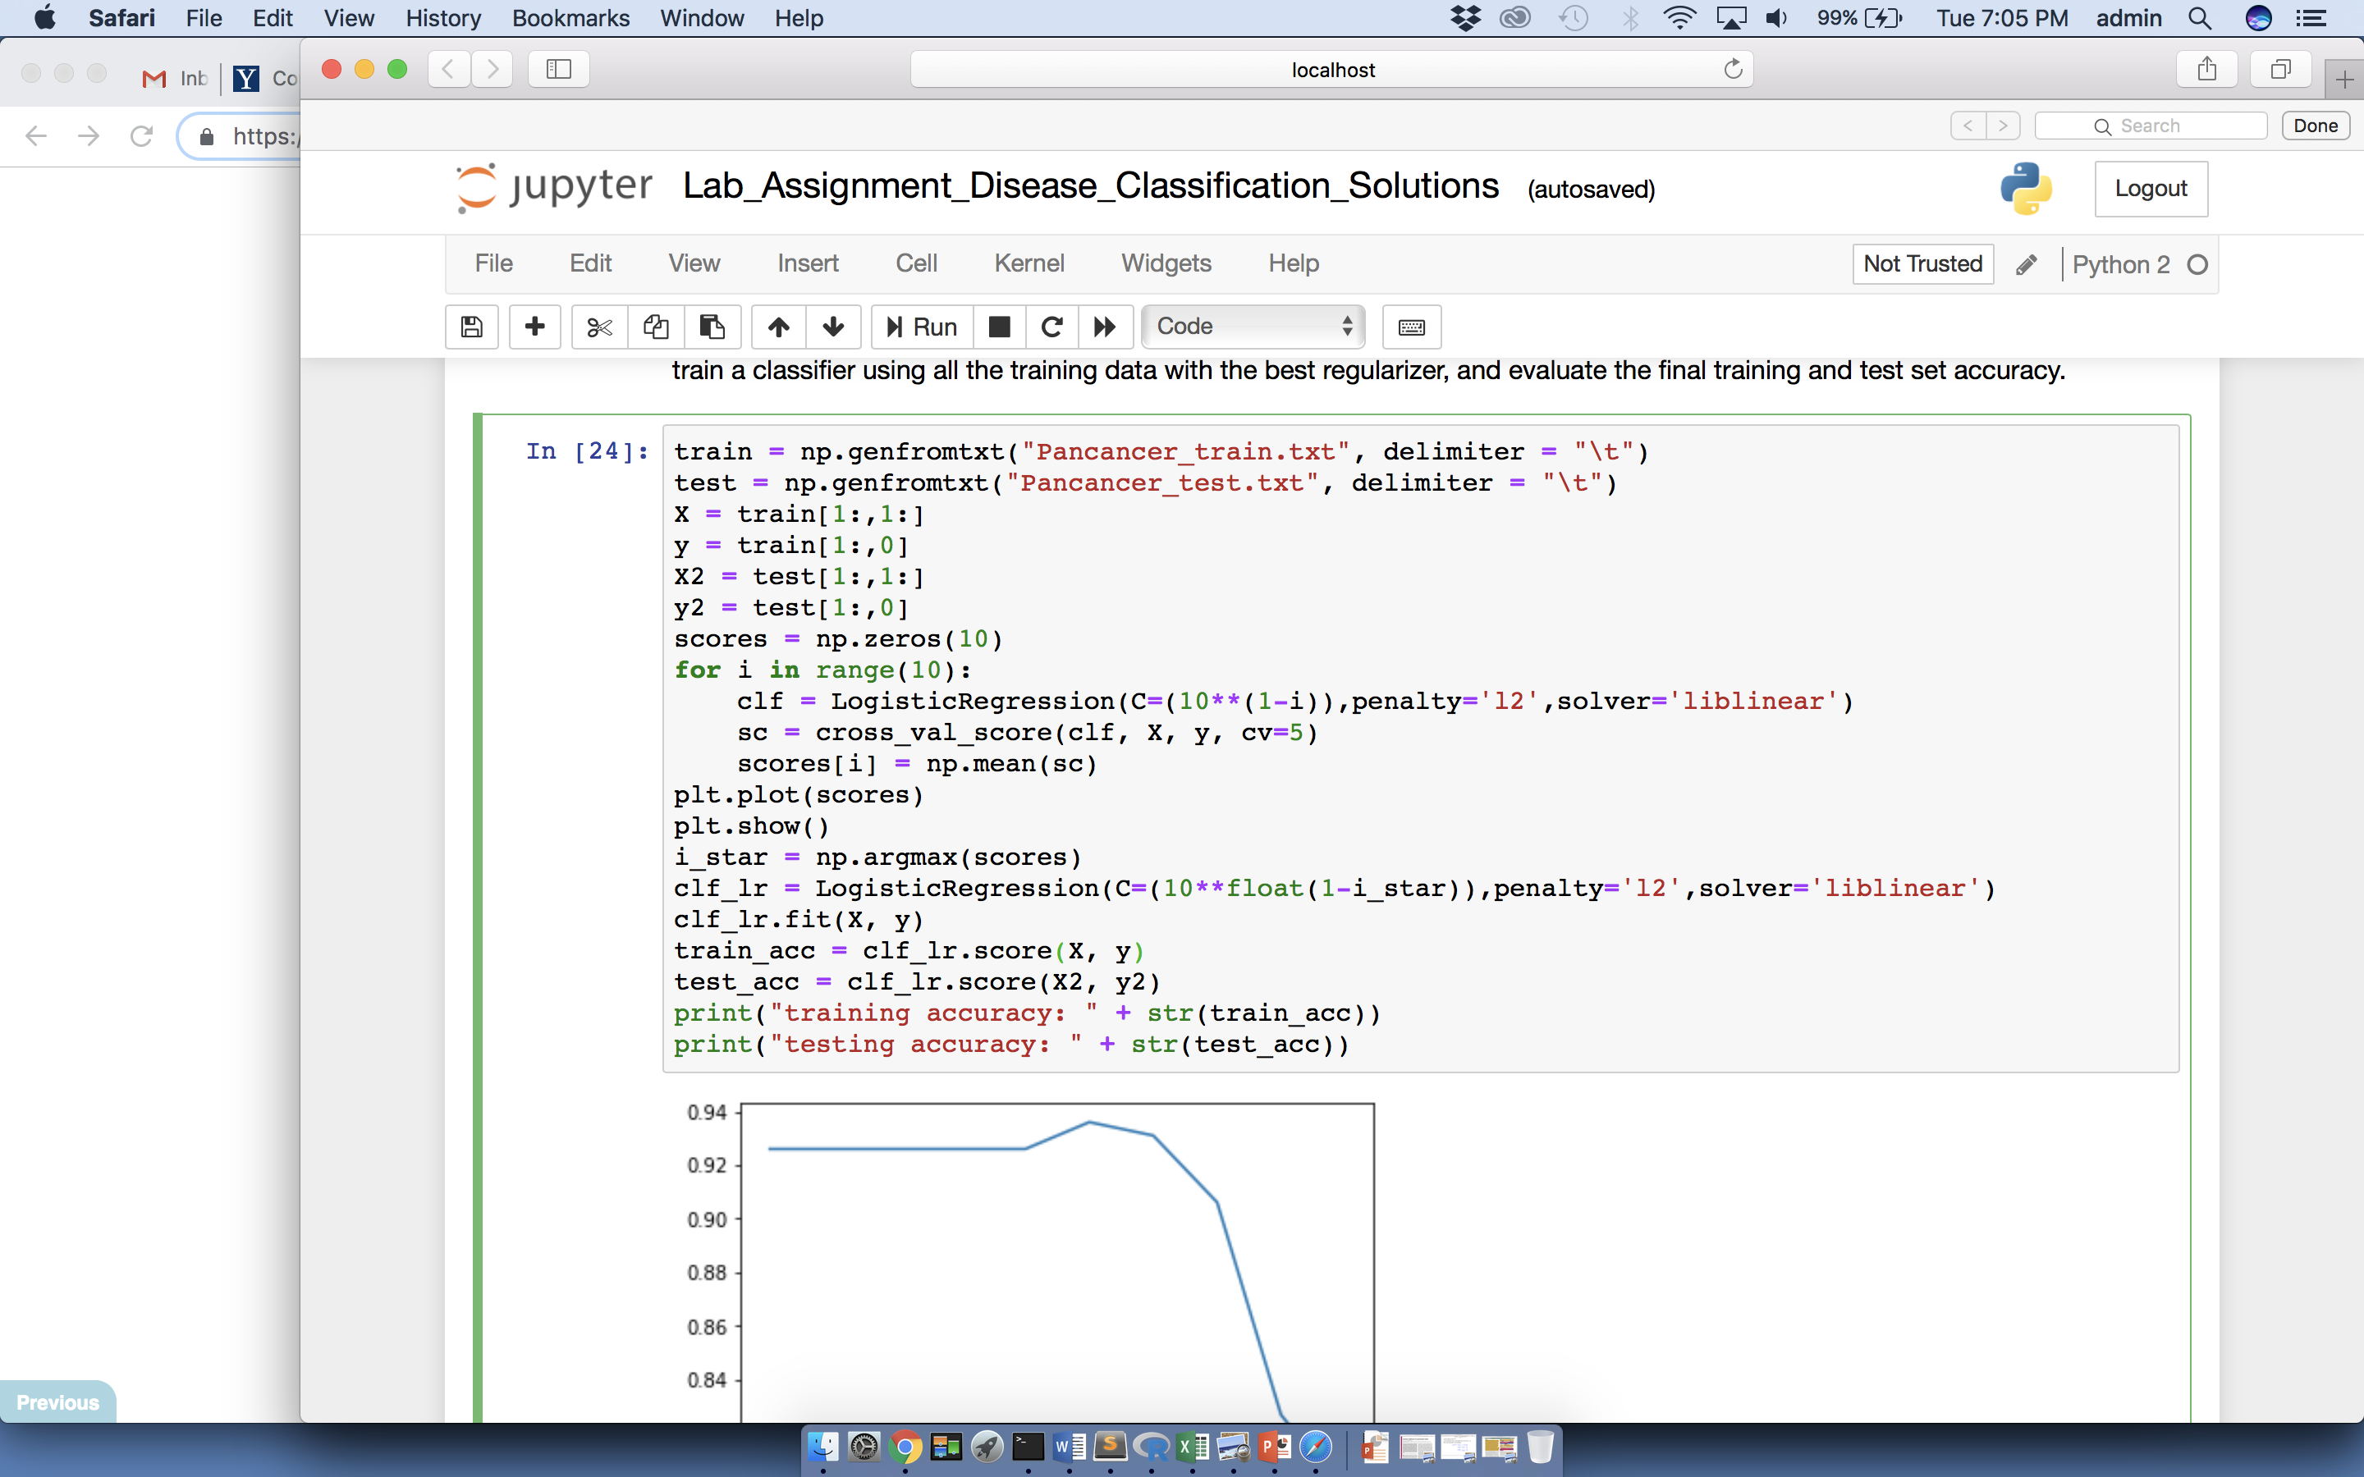
Logistic Regression (contd.)
scikit-learn Code:
1. Import library:
2. Using previously imported data, fit model to estimate logistic regression parameters:

Slide 48
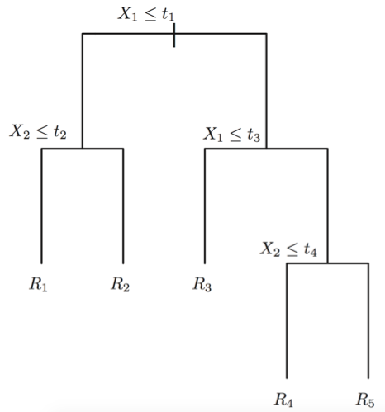
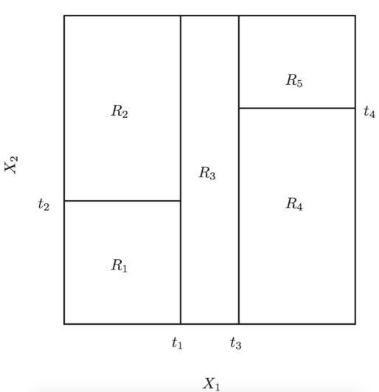
Supervised Learning II: Tree-based methods (such as Random Forests)
Definition: The idea is to partition the parameter space in such a way that each split in the space results in the best prediction within each subspace
Left: A 2-dimensional parameter space is partitioned into 5 subspaces
Right: Tree representation of the resultant partition
Let X₁ = gene dosage
Let X₂ = age
James et al., 2013

Slide 49
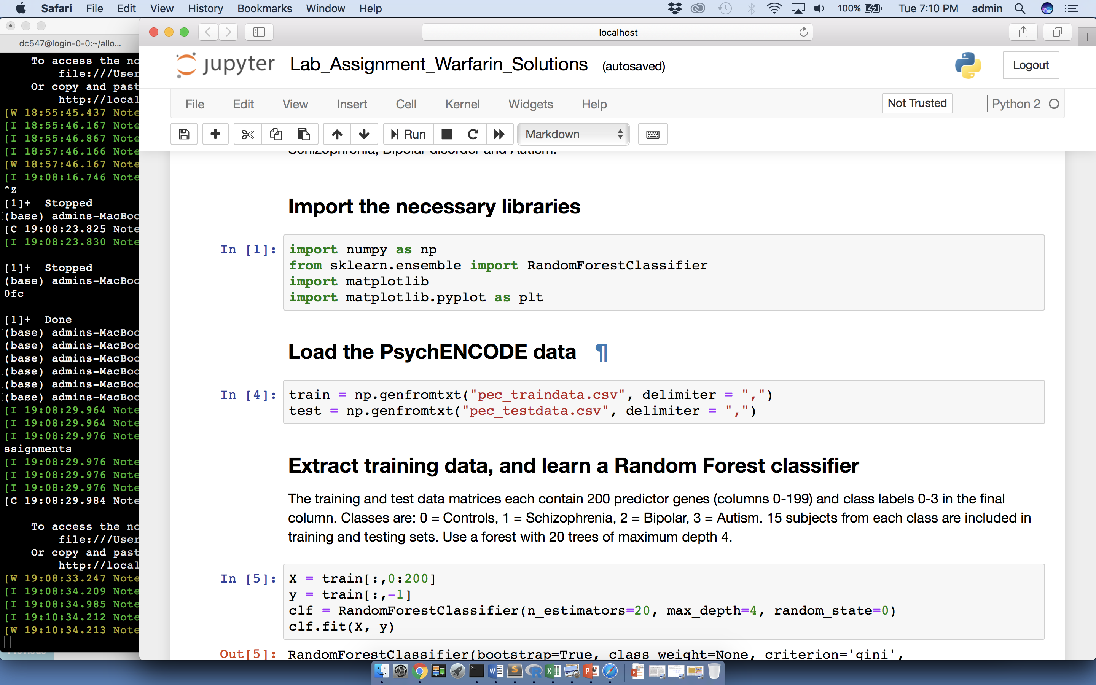
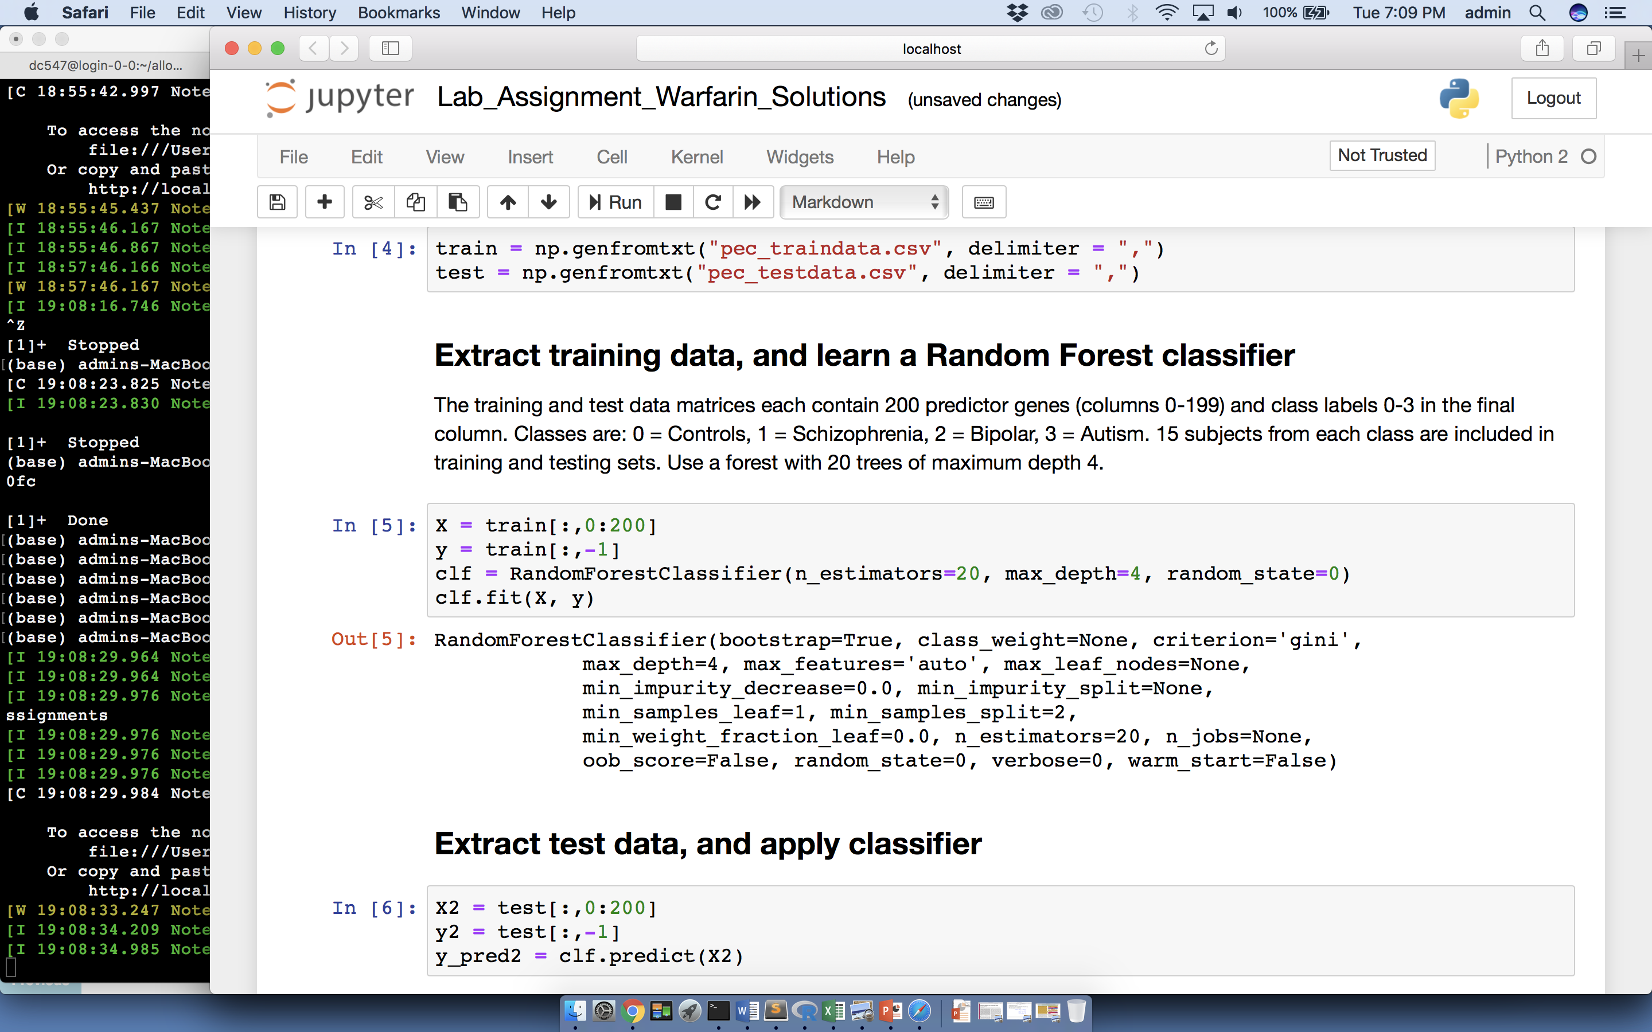
Tree-based methods (contd.)
scikit-learn Code:
1. Import library:
2. Using previously imported data (X and y), build a random forest classifier:

Slide 50
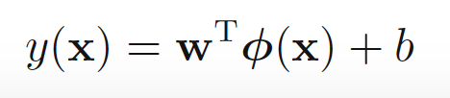
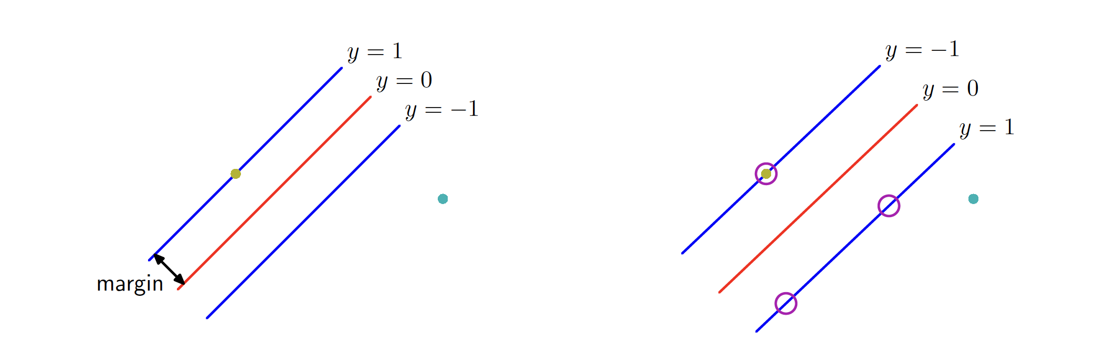
Supervised Learning III: Non-linear Supervised Methods: SVMs
Linear SVMs learn a classifier in the original feature space
Non-linear SVMs learn a classifier in a transformed feature space; this may be high-dimensional
SVMs maximize the margin in the high-d feature space
C. Bishop, 2006

Slide 51
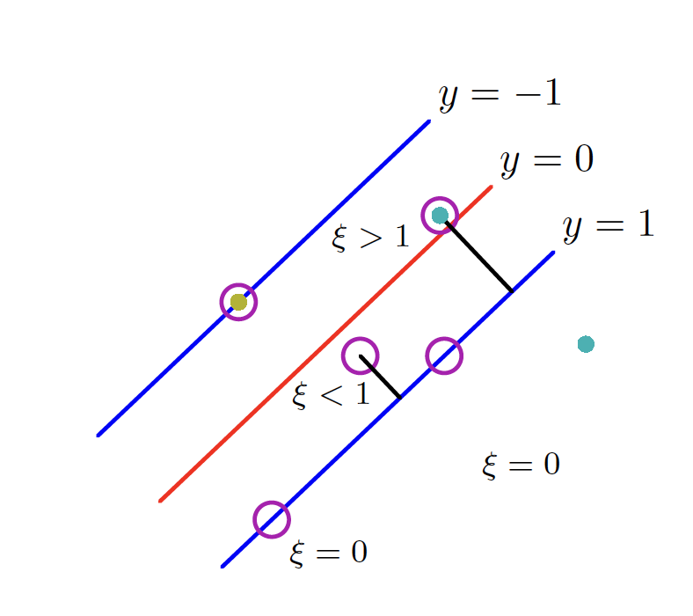
Non-linear Supervised Methods: SVMs
If data is not separable, may introduce slack-variables
C. Bishop, 2006

Slide 52
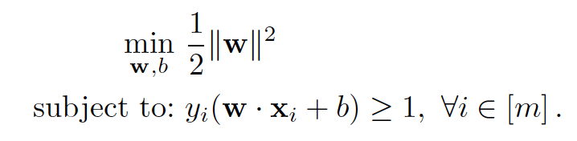
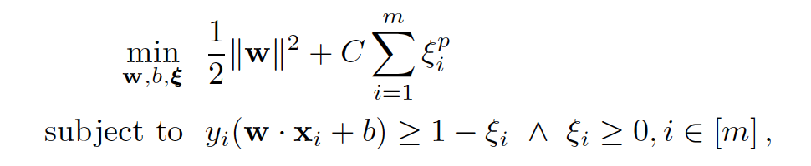
Non-linear Supervised Methods: SVMs
Can be formulated as a quadratic (convex) optimization problem
Separable:
Non-separable:
Mohri et. al., 2018

Slide 53


Non-linear Supervised Methods: SVMs
SVMs can use different kernels to increase complexity of feature space
Linear:
K(x,x’) = x^{T}x’ + c
Polynomial:
Gaussian (RBF):

Slide 54

Non-linear Supervised Methods: SVMs
Gaussian (RBF) kernel example:
C. Bishop, 2006

Slide 55


Non-linear Supervised Methods: SVMs
scikit-learn code:
1. Training and testing:
2. Useful code: cross validation

Slide 56




Supervised Learning IV: Non-linear Supervised Methods: Neural Networks
Neural networks include a series of hidden layers between input and output
Recursive definition:
Compare to logistic regression:
$$P\left(y\right)=σ(w^{T}x+b)$$
C. Bishop, 2006; Goodfellow et. al., 2016

Slide 57





Non-linear Supervised Methods: Neural Networks
Neural networks are typically trained using back-propagation
Back-propagation used to evaluate
May also use stochastic gradient descent (SGD) for robustness
Can use many different activation functions
Sigmoid
Tanh
RELU
Soft-max …
Gradient descent:
Sigmoid
RELU

Slide 58


Non-linear Supervised Methods: Neural Networks
Different kinds of NN used in deep-learning:
Fully connected
Convolutional (CNN)
Recurrent (RNN, LSTM)
Generative (VAE, GAN, DBM)
CNN:
RNN:
Goodfellow et. al., 2016

Slide 59

Non-linear Supervised Methods: Neural Networks
Examples of uses in Bioinformatics and generally
Natural language processing (NLP)
Epigenomics (binding site prediction etc.)
Disease prediction
Image-based diagnosis
scikit code (MLP = multilayer perceptron = fully connected NN):

Slide 60
Model training and evaluation: Cross Validation
Schematic of cross-validation based training:
Use training set partitions to set hyper-parameters: e.g. for each hyper-parameter setting, train on 4 partitions and test on 1, and calculate mean score over 5 divisions
Choose hyper-parameters with best score, and retrain on whole training set
Assess performance on hold out testing set data
scikit code:
Training set (75%), with cross validation partitions:
Testing set (25%):

Slide 61




Model training and evaluation: ROC curves
Post training, any classifier outputting continuous scores can be assessed across a range of operating points, which trade off the cost of making type I and type II errors.
Trade off represented by an ROC curve, and general performance assessed using area under the curve (AUC)
scikit code:
James et. al., 2013

Slide 62
Model training and evaluation: Model interpretation
Different models require different kinds of interpretation
Logistic regression and linear SVMs are directly interpretable: the most important features are those whose coefficients have the highest absolute values (+ve and –ve)
Non-linear SVMs can be interpreted by considering the examples selected as support vectors
Random forests can be interpreted by looking at the features most used to split the data
Neural Networks are harder to interpret: a simple approach is to evaluate the gradient of the output with respect to each feature

Slide 63
References
Machine Learning References:
Bishop, Christopher M. Pattern recognition and machine learning. Springer, 2006.
Hands-on machine learning with Scikit-Learn and TensorFlow : concepts, tools, and techniques to build intelligent systems, Aurélien Géron, O’Reilly Media 2017.
James, G., Witten, D., Hastie, T., & Tibshirani, R. (2013). An Introduction to Statistical Learning with applications in R. Springer.
Goodfellow, Ian, Yoshua Bengio, and Aaron Courville. Deep learning. MIT press, 2016.
Mohri, Mehryar, Afshin Rostamizadeh, and Ameet Talwalkar. Foundations of machine learning. MIT press, 2018.

Slide 64
References (contd.)
Silver et al. 2016, “Mastering the game of Go with deep neural networks and tree search”, Nature 529, Pgs. 484-489.

